Slide 1


DSPG 2018 Midterm Update Presentations
Presentation to Michelle Gregory and Team,
Health and Human Services, Fairfax County
November 1, 2017

Slide 2
time set | ref. | Project Title | Sponsoring Agency | Point(s) of Contact | Lead | SDAL Team | Fellow(s) | Alumni & Students
9:15 | STEM | STEM Pathways | NCSES, NSF | Karen Hamrick, NCSES | Bianica | Ian, Sallie | Emily | Hannah and Raghav
9:30 | Business Innovation | Measuring Business Innovation Using Non-Traditional Data Sources | NCSES, NSF | Gary Anderson, NCSES | Gizem | Stephanie, Ian | Fangfang Bayoan | Eirik, Raghav, and Luke
9:45 | OSS | Measuring the Scope and Impact of Open Source Software Innovation | NCSES, NSF | Carol Robbins, NCSES | Gizem | Stephanie, Daniel, Ian | Bayoan | Hannah, Eirik and Keren
10:00 | VT Metrics | New Metrics for Assessing Virginia Tech Student Success | VT Office of Academic Decision Support | Ken Smith, VT Vice Provost | Aaron | Sallie, Gizem | Devika Davon | Jay and Doug
10:15 | VCE | VCE Community Dashboard | Virginia Cooperative Extension (VCE) | Michael Lambur, Associate Director, Program Development | Aaron | Stephanie, Brian | Devika | Cory and Luke
10:30 | ARI2 | Community Embeddedness of Army Soldiers | ARI (Social and Behavioral Sciences) | Kelly Erin, Joel Thurston, and Nathaniel Ratcliff, ARI | Josh | Stephanie, Vicki | Emily Daniel | Megan and Kelsey
10:45 | Roanoke | Create Community-Scapes for City of Roanoke and Allegheny Valley Regions in VA | Roanoke Valley Alleghany Regional Commission | Wayne Strickland, RVARC | Stephanie | Vicki, Josh | Davon | Eirik, Doug and Cory
11:00 | CPN | Arlington Equity Composite Indicators | Community Progress Network | Nathanial Root, Jose Quinonez, and Cheryl Ramp, CPN | Vicki | Stephanie, Josh, Brian | Davon Devika | Jay and Armi
11:15 | DHS | DHS Data Linkage & Characterization Phase II | Arlington County Department of Human Services (DHS) | Martha Coello, IT Manager, Finance and Information Systems Division | Ian | Aaron | Fangfang | Keren
11:30 | ACPD | Alcohol-Related Crime Reduction Strategies for Restaurants and Nightlife in Arlington | Arlington County Police Department (ACPD) | Dimitrios Mastoras, ACPD Bruce Benson, ACPD Niki Levy, ACPD | Gizem | Aaron, Sallie | Bayoan | Hannah, Kelsey, and Alexa
11:45 | VDSS | Fitness of VDSS Administrative Data Sources | Virginia Department of Social Services (VDSS) | Jeff Price, VDSS | Brian | Aaron | Daniel Fangfang | Megan and Alexa
12:00 | UMFS | Foster Parent Recruitment and Disruptions in Foster Care | United Methodist Foster Services (UMFS) | Nancy Campos, UMFS | Brian | Josh | Daniel | Armi

Slide 3
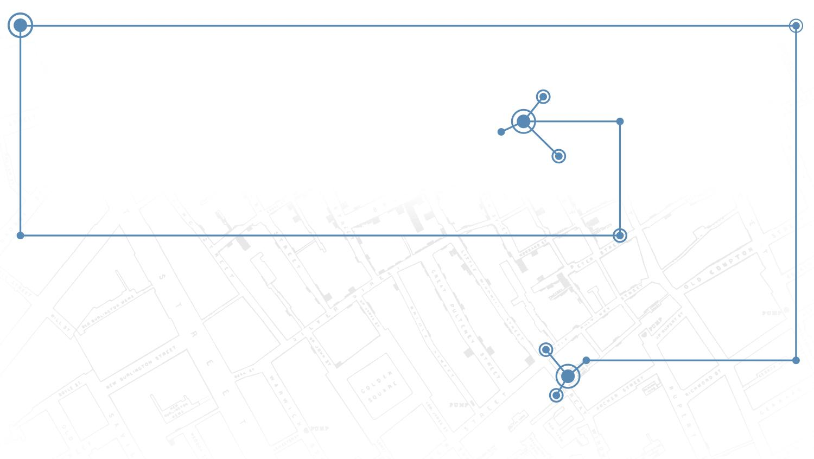
Identifying STEM Pathways
PI: Bianica Pires
SDAL Leads: Ian Crandell, Sallie Keller
Team: Hannah Brinkley, Raghav Sawhney, Emily Sheen
Sponsor: Karen Hamrick, National Center for
Science and Engineering Statistics (NCSES)
Notes:
This is the STEM pathways project led by Bianica Pires, Ian Crandell, and Sallie Keller. This project is sponsored Karen Hamrick from the National Center for Science and Engineering Statistics, NCSES
I am Hannah Brinkley, a rising junior at Virginia Tech studying Computer Science

Slide 4
Research Question
What are the high school to workforce pathways that lead to a STEM or STEM-related occupation?
Focus on high school to post-secondary and workforce pathways in Virginia
Longitudinal Focus: ultimately trying to bridge individuals/ groups
Notes:
Emily/ Hannah

Slide 5
Introduction
Problem Statement: Identify and measure education and training pathways to STEM and STEM-related occupations
NCSES relies on surveys to understand the landscape of STEM graduates and the STEM workforce
Current NCSES reporting focuses on the ‘traditional’ pipeline of STEM education and training from high school to STEM occupation (e.g., National Survey of College Graduates, Survey of Earned Doctorates)
Half of all STEM jobs are available to workers without a 4-year degree and the pathways that lead to these jobs are diverse and not well-understood. Currently, there is a gap in understanding for skilled-technical STEM workers with less than a 4 year degree
Notes:
Emily/ Hannah
Current NCSES reporting (in response to possible question from Sallie) =
counts of degrees awarded in different fields by race/gender/demographics
elementary-high school science and mathematics scores & course enrollment
Strong focus on PhD level, at least bachelor's: degrees earned
Rising tuition costs
Very little longitudinal studies, tying from high school to college/training/certs to workforce and back to training.

Slide 6
Importance
STEM workforce contributes most innovation, higher wages, better economic conditions, US competition with other countries
Want to understand pathways to the STEM workforce and encourage students to enter this field
Special focus on skilled-technical STEM occupations, which are not well understood (gap in NCSES reporting)
What are the necessary skills for STEM occupations, how does education/training prepare or fail to prepare workers
Notes:
Emily/ Hannah

Slide 7
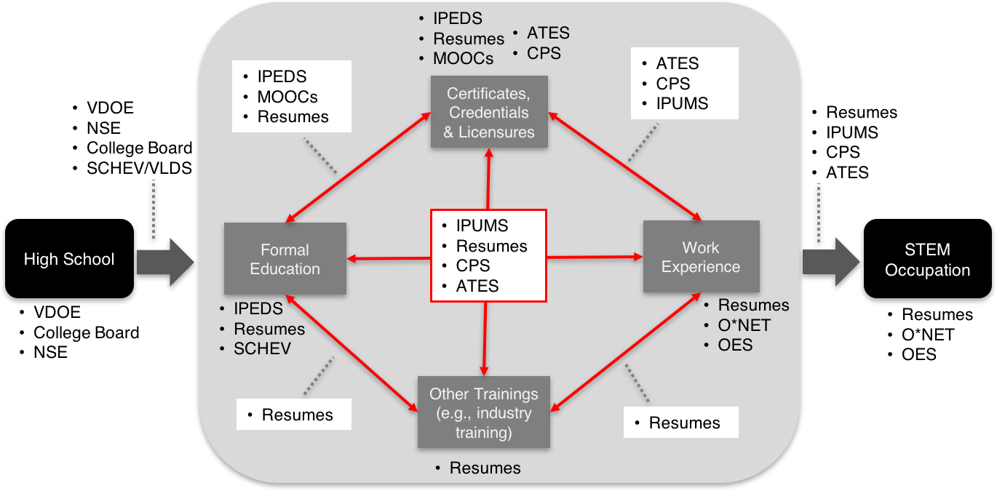
STEM Pathways Data Map
(Work-in-Progress)
Notes:
Raghav
VDOE = Virginia Department of Education
NSE = National Student Clearinghouse
SCHEV = School Council of Higher Education for Virginia
VLDS = Virginia Longitudinal Data Systems
IPEDS = Integrated Postsecondary Education Data System
MOOC = Massive open online courses
CPS = Current population survey
ATES = Adult training and education survey
IPUMS = Integrated public use microdata series
OES = Occupational employment survey

Slide 8
Data Discovery
Focus of the data discovery process was on sub-baccalaureate education and training pathways
Data source | Description
Integrated Postsecondary Education Data System (IPEDS) | IPEDS is a system of surveys conducted annually by the the National Center for Education Statistics (NCES). IPEDS gathers information from every college, university, and technical and vocational institution that participates in the federal student financial aid programs.
Adult Training and Education Survey (ATES) | ATES is a survey conducted by NCES as part of their objective to collect data on 1) the attainment of non-degree credentials, including industry-recognized certifications, occupational licenses, and educational certificates, and 2) enrollment in education and training that prepares people for work.
MOOC providers & aggregators | Massive open online courses (MOOCs) include Coursera, Udacity, HarvardX, MITX, and edX. MOOC aggregators such as Class Central provide one stop access to courses across a variety of MOOCs.
Current Population Survey (CPS) data on Certificates and Licenses | CPS is a monthly survey of households conducted by Census for the Bureau of Labor Statistics (BLS). This survey includes data on certificates and licenses data by employment status.
National Student Clearinghouse (NSE) | NSE is the largest provider of transcript ordering services & electronic student record exchange, degree verification and enrollment verification for private companies. They maintain student-level data on education and enrollment.
Notes:
Raghav
We focused the data discovery process on finding data sources that would help us understand the landscape of sub-baccalaureate education and training pathways (such as certificates/credentials, MOOCs, vocational schools, community colleges).
The table provides a brief description of some of the main data sources we think may be most useful for this project.

Slide 9
IPEDS Data Exploration
IPEDS is a system of surveys conducted by the National Center for Education Statistics
Provides publically available data across 12 surveys
The unit of analysis is the institution
Some survey results go back to 1980
We combined 5 years of data across 4 of the surveys (i.e., institutional characteristics, completions, fall enrollment, outcome measures)
Reviewed over 400 variables across these surveys and selected approximately 50 to profile and explore
Notes:
Raghav
We selected the IPEDS data to explore first.

Slide 10
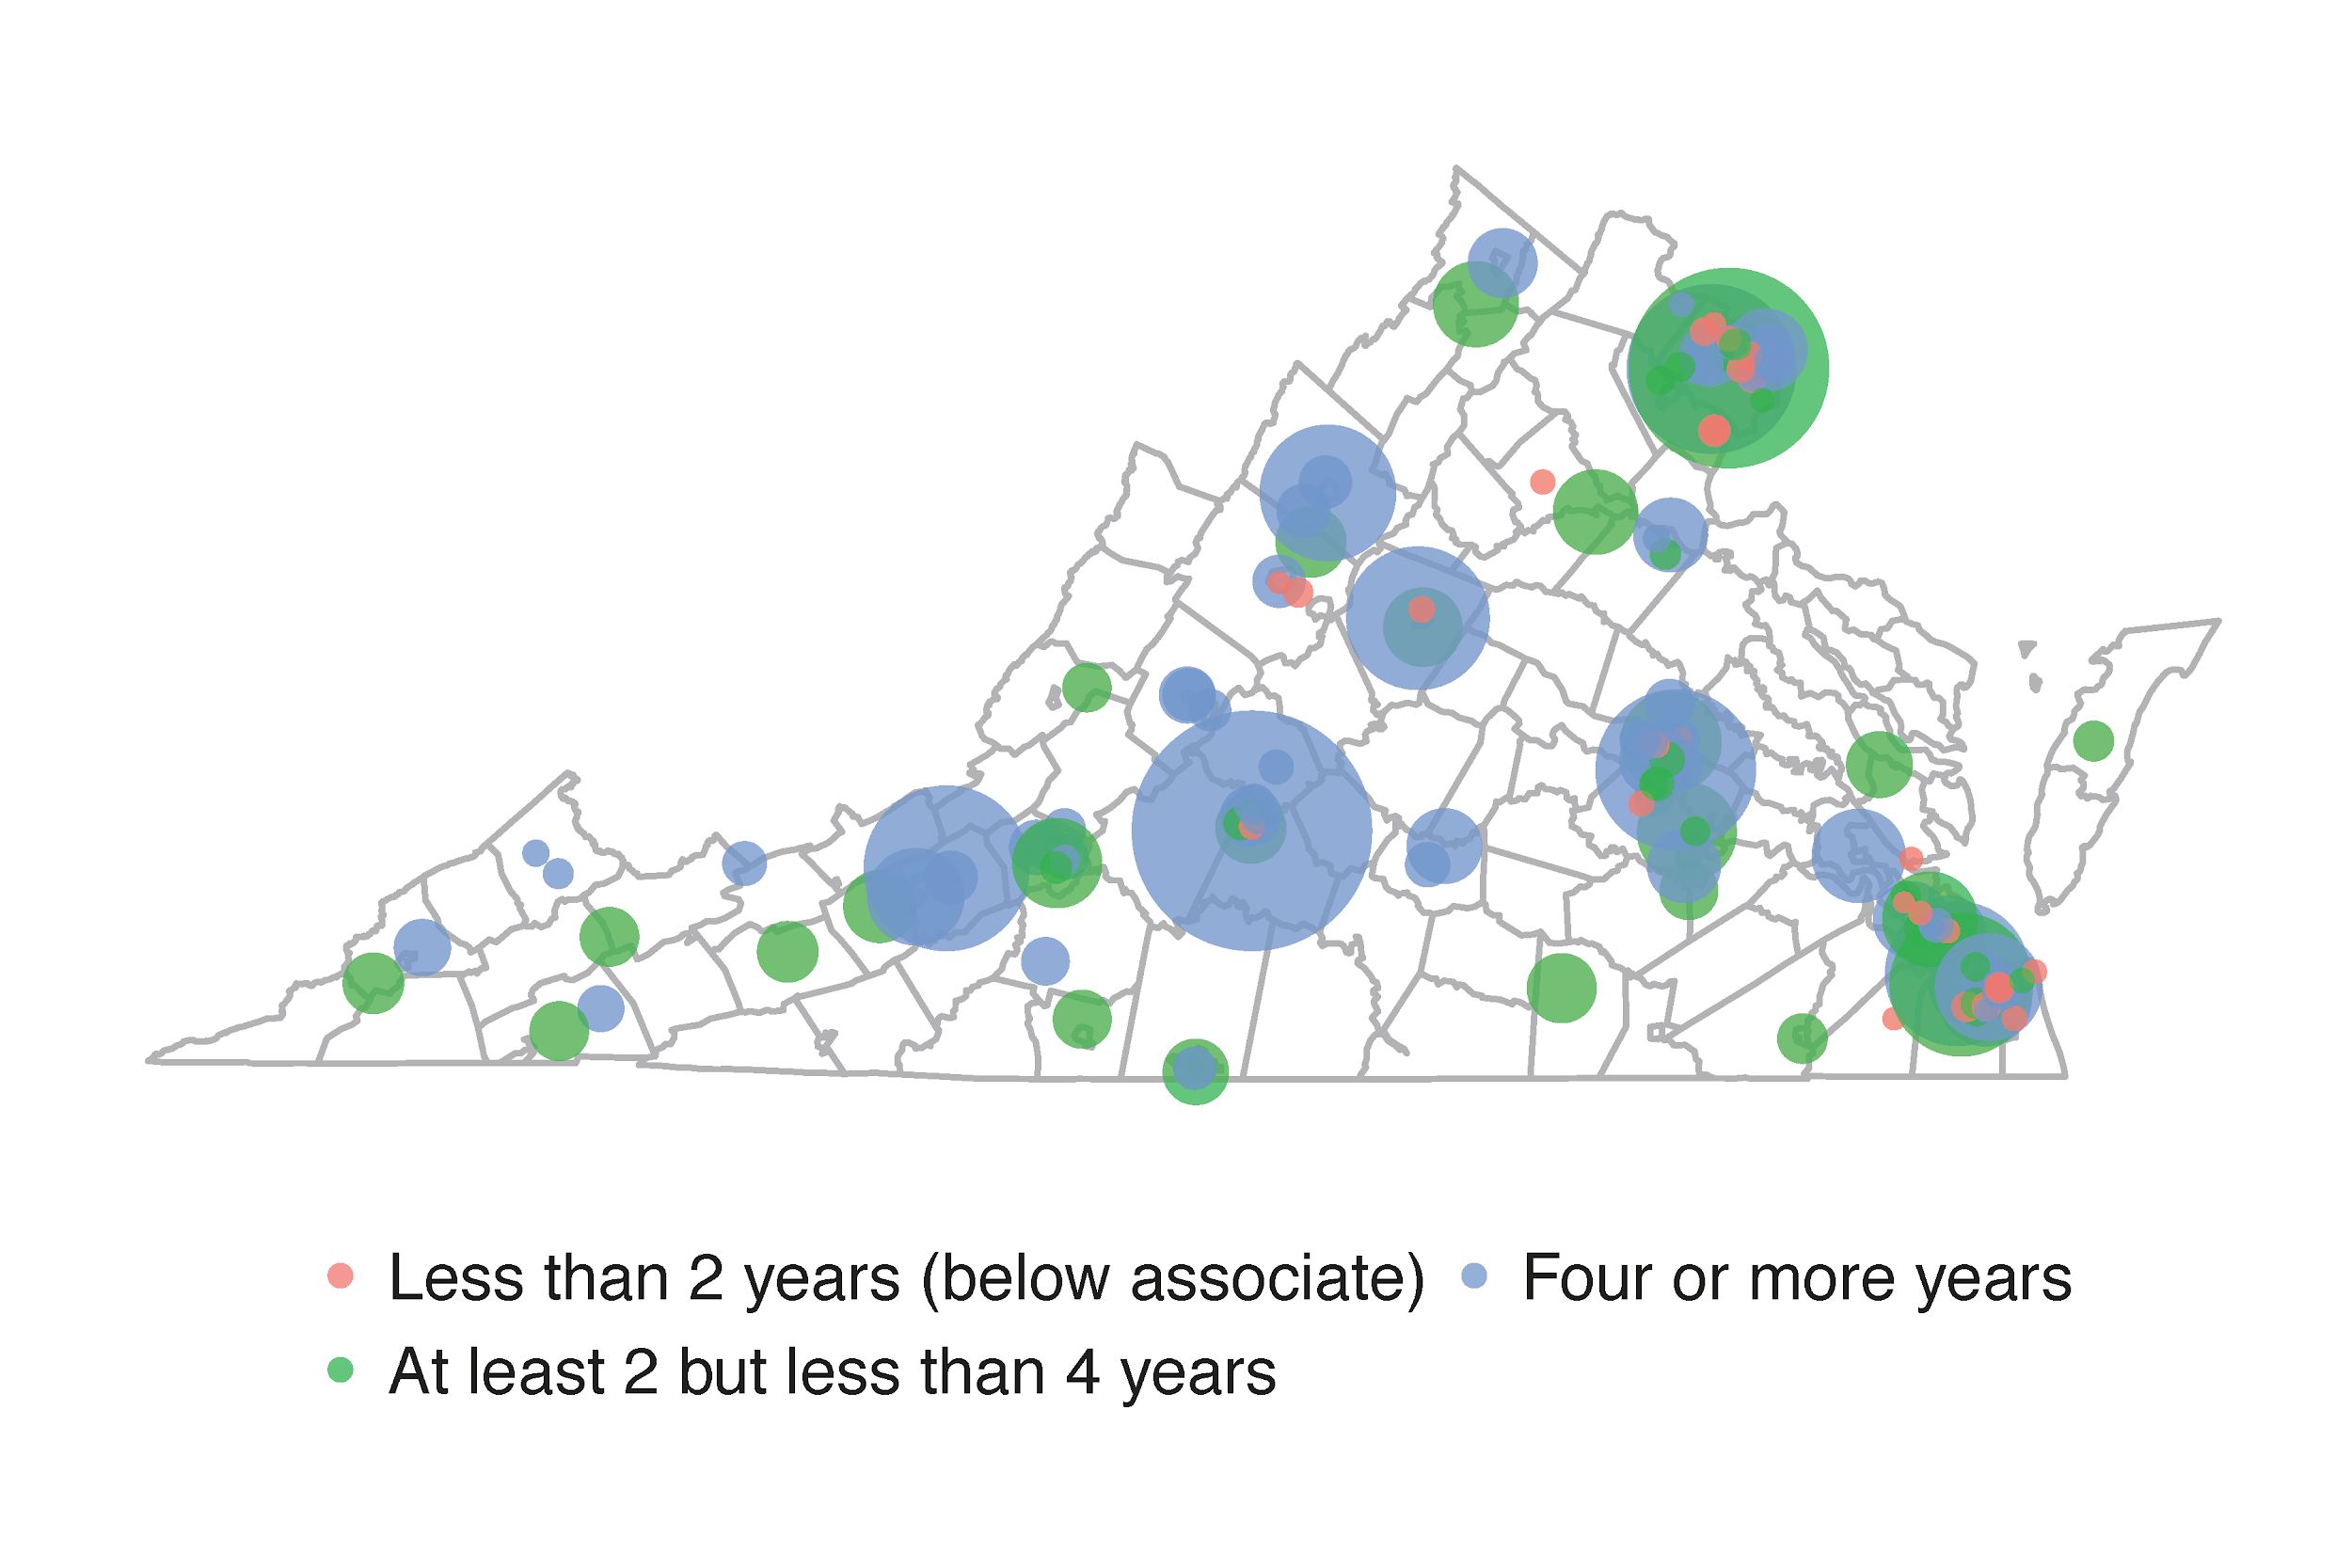
Institutions in Virginia
There are 173 institutions in Virginia
40 are less than 2 year institutions
49 are at least 2 years but less than 4 year institutions
83 are four or more years institutions
The average fall enrollment size in 2016 was 3,528
The smallest enrollment size was 9 and largest was over 75,756
Data Source: IPEDS, 2016
Notes:
Raghav
We combined the institutional characteristics survey with the fall enrollment survey to create this map.
Each dot represents an institution.
The dot colors represent the type of institution (ie., less than 2 years, at least 2 but less than 4 years, and four or more years).
The size of the dots represent the number of students enrolled at the institution in 2016
The smallest institution is Danville Regional Medical Center School of Health Professions
The largest institution is Liberty University
Average enrollment sizes:
97 at less than 2 year institutions
3,718 at least 2 years but less than 4 years institutions
4,924 at four or more years institutions

Slide 11
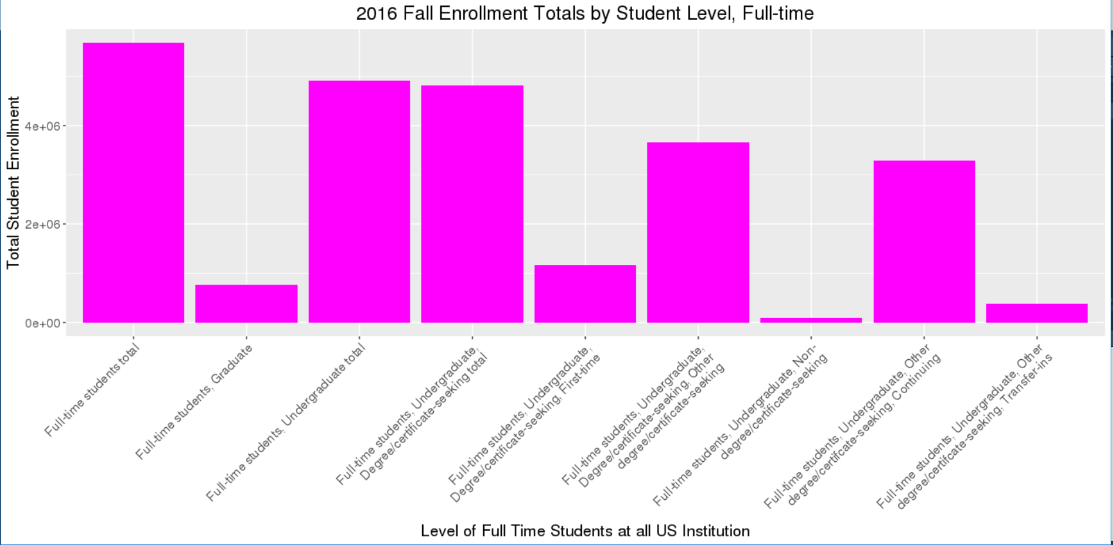
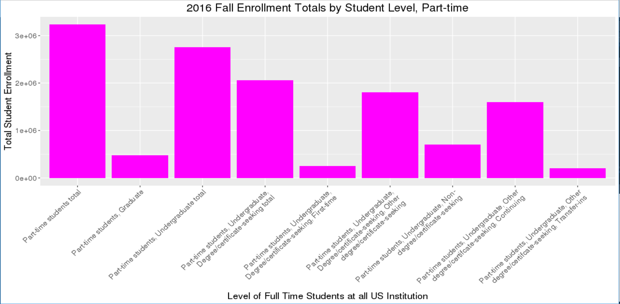
Enrollment by Student Level (Full-time and Part-time)
Data Source: IPEDS, 2016
Notes:
Raghav
IPEDS allows us to look at enrollment counts by different student classifications - including non-degree seeking full-time and part-time students

Slide 12
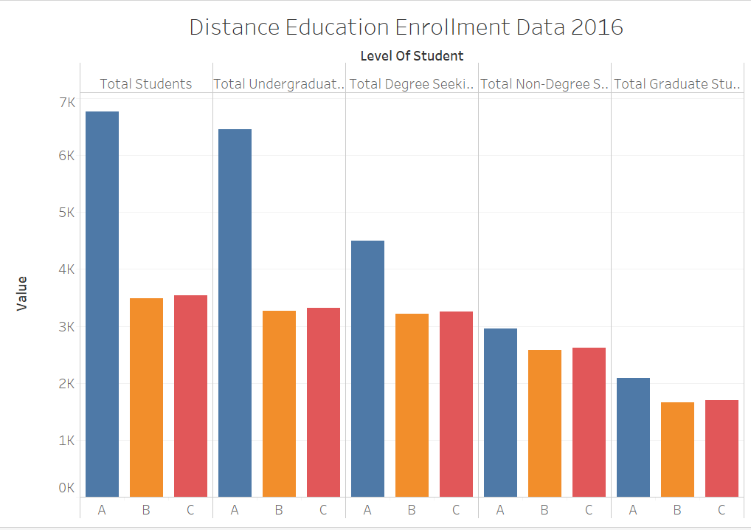
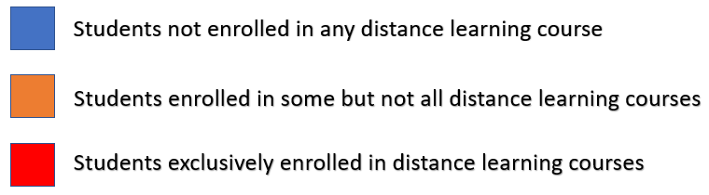
Enrollment in Distance Education
Notes:
Raghav
IPEDS also has data on students enrolled in distance education at each institution. We can compare the number of students in distance education to their classification (e.g., degree or non-degree seeking)

Slide 13
What are MOOCs?
A MOOC (massive open online course) is an online course that is free and widely accessible
Hosted/ taught by professors from universities
Students do not need to attend a specific university to enroll in a certain MOOC
Distance learning is taking a course remotely usually through the internet using university-provided resources and tutorials
Sometimes this includes interaction between instructor and student through telephone, email, etc.
Only offered to enrolled students at a particular university
Alternative to participating in a course that meets in a physical classroom
IPEDS captures distance learning enrollment at institutions but does not provide information on MOOCs
Notes:
Hannah
https://library.educause.edu/topics/teaching-and-learning/massive-open-online-course-mooc
https://www.thecompleteuniversityguide.co.uk/distance-learning/what-is-distance-learning/

Slide 14
Examples of MOOCs
Name | Number of Courses | Background
Coursera | 3419 | Launched in 2012, Coursera is currently the largest MOOC in the world
edX | 2190 | Founded by Harvard and MIT in 2012, has partners with over 100 universities, including Harvard and MIT
Harvardx | 129 | The range of online courses taught by Harvard on edX
MITx | 160 | The range of online courses taught by MIT on edX
Udacity | 226 | Udacity was created in 2011 and partners with technology companies to offer Nanodegrees that train students for specific jobs
Notes:
Hannah
MTurk survey - NSF did pilot on this - had a lot of success
Could a supplement of current surveys get at the evolving trends in education, eg., degree through coursera, new school in california
Resumes, supplement resumes

Slide 15
HarvardX / MITX Summary Data
Course Category | % Participants | % Explored | % Certified | % Female | % Bachelors
STEM | 73% (3,234,151) | 16% | 5% | 23% | 64%
Non-STEM | 27% (1,215,706) | 19% | 7% | 41% | 74%
Data Source: HarvardX/MITX MOOC enrollment, 2012-2016
Notes:
Hannah

Slide 16
Next Steps
Profile and explore additional IPEDS variables, ATES & CPS surveys on certifications and licenses
Explore options for data access from MOOC providers (e.g., Coursera, Udacity) and aggregators (e.g., Class Central)
Statistical modeling of high school to postsecondary pathways in Virginia
Complete data preparation for all high schools in Virginia
Develop predictive and statistical models to explore factors influencing distinct pathways, including high schools’ “college-going” culture
Notes:
Hannah

Slide 17
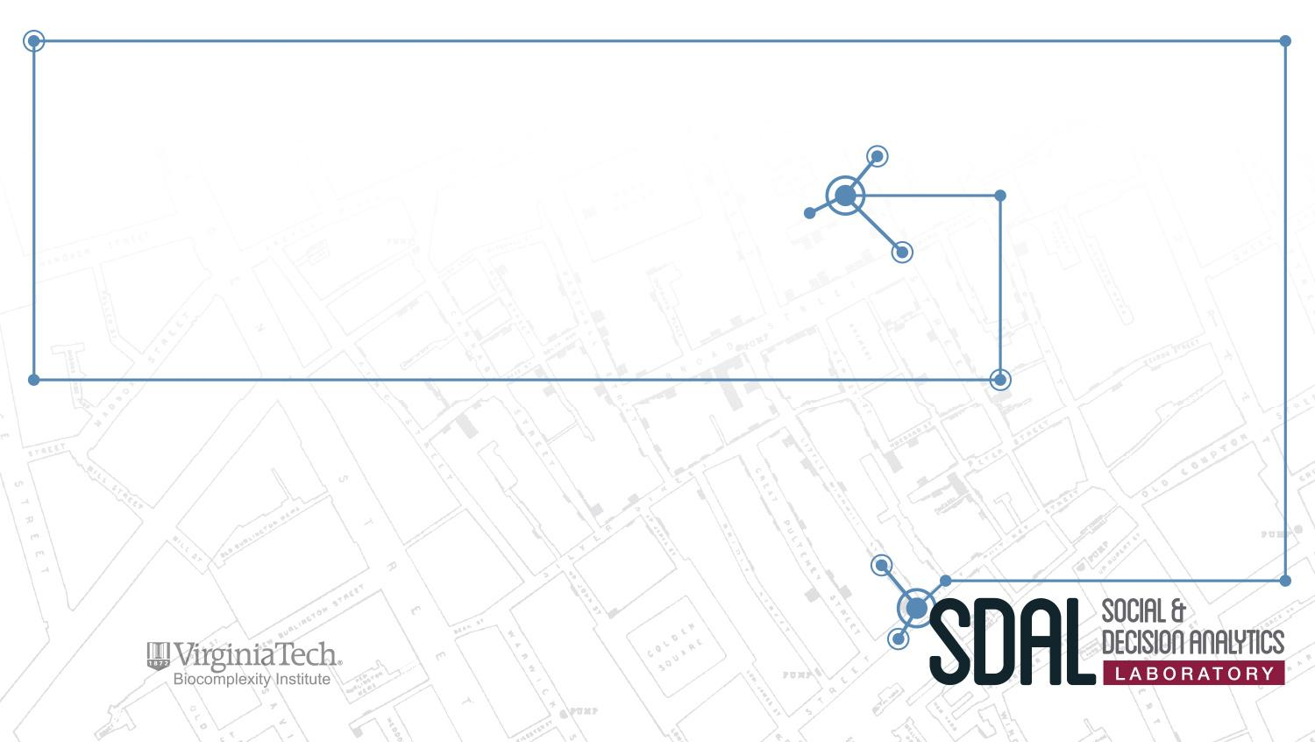

Measuring Business Innovation Using Non-Traditional Data Sources
PI: Gizem Korkmaz
SDAL Leads: Ian Crandell and Stephanie Shipp
Team: Fangfang Lee, Eirik Iversen, Luke Kim, Raghav Sawhney
Sponsor: Gary Anderson, National Science Foundation (NSF) National Center for Science and Engineering Statistics (NCSES)

Slide 18
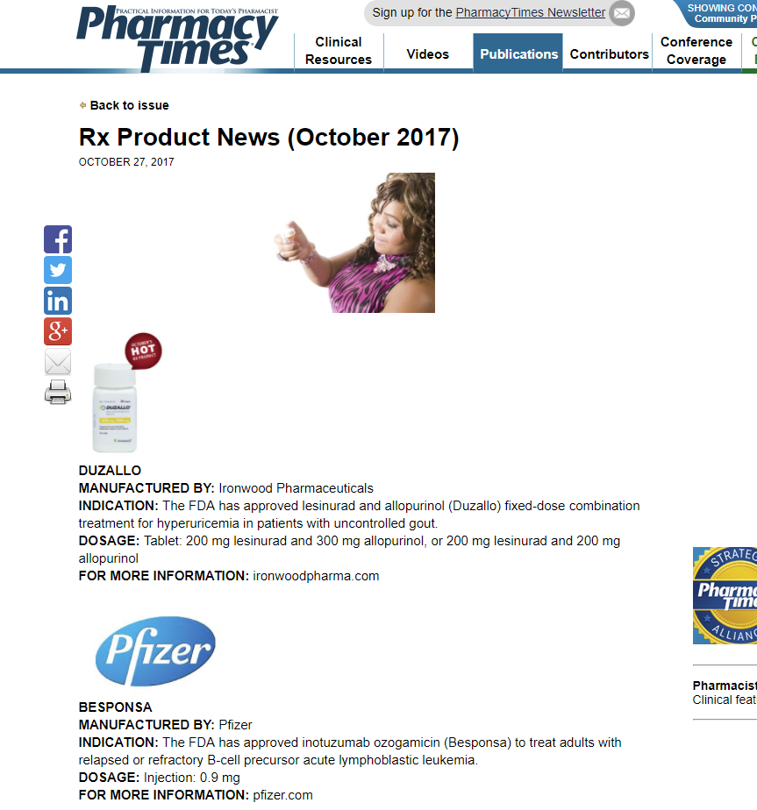
Business Innovation in Pharma
Is it possible to reliably identify the incidence of product innovation in particular industries, along lines of Oslo Manual definition.
Pharmaceutical industry:
Drugs and medical devices
NAICS 33911- Medical Equipment and Supplies Manufacturing
NAICS 32541 - Pharmaceutical and Medicine Manufacturing
Which data sources will allow us to quantify more accurately the number and types of new products being introduced? (an innovation metric)
FDA.gov
Trade Journals
Proquest Database

Slide 19
Data Source I: FDA Medical Device Databases
Databases:
Medical devices are classified by the amount of risk (class I, II, III)
PMA, 510(k), HDE
Collection
Scraped and downloaded data through API and database portal
Main target:
applicant- company & lab names
approved date
device name
Challenges
Multiple classifications and acquiring definitions of variables and decision codes
PMA Data Profiles example
variable names | Description | Values (examples) | missing values (%) | uniqueness | # of items within target date range
applicant | Company name | LivaNova USA, Inc., St. Jude Medical | 0 | 284 | 6986
decision_date | date for the decision made | 2013-04-06 | 0 | 755
trade_name | name of the device used for sales | MICRA, VITREON(R), ABBOTT REALTIME HBV | 0 | 3968

Slide 20
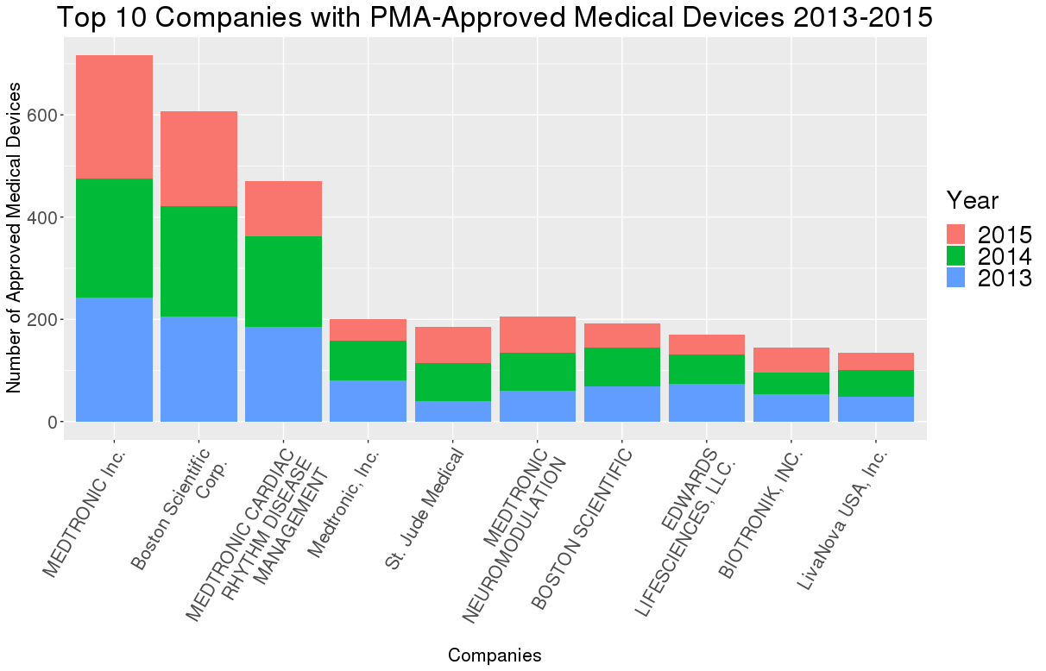
Data Analysis: FDA Databases
FDA:
Medical Devices
Analysis
Completeness, Uniqueness, and top leading companies that produce medical devices
Next Steps
Analyze the rest of database results

Slide 21
Data Source II: Trade Journals
Drugs
Pharmacy Times (‘17)
Pharmacy Today (‘17)
Medical Devices
Surgical Products
Medical Design Briefs
Notes:
we found a list of about 60 trade journals online, and filtered through all of them. We selected the trade journals based on whether the access is free, how easy it is to scrape, and whether it has a dedicated new product section. Based on these criteria, we found surgical products and medical design briefs to be the best scraping candidates.

Slide 22
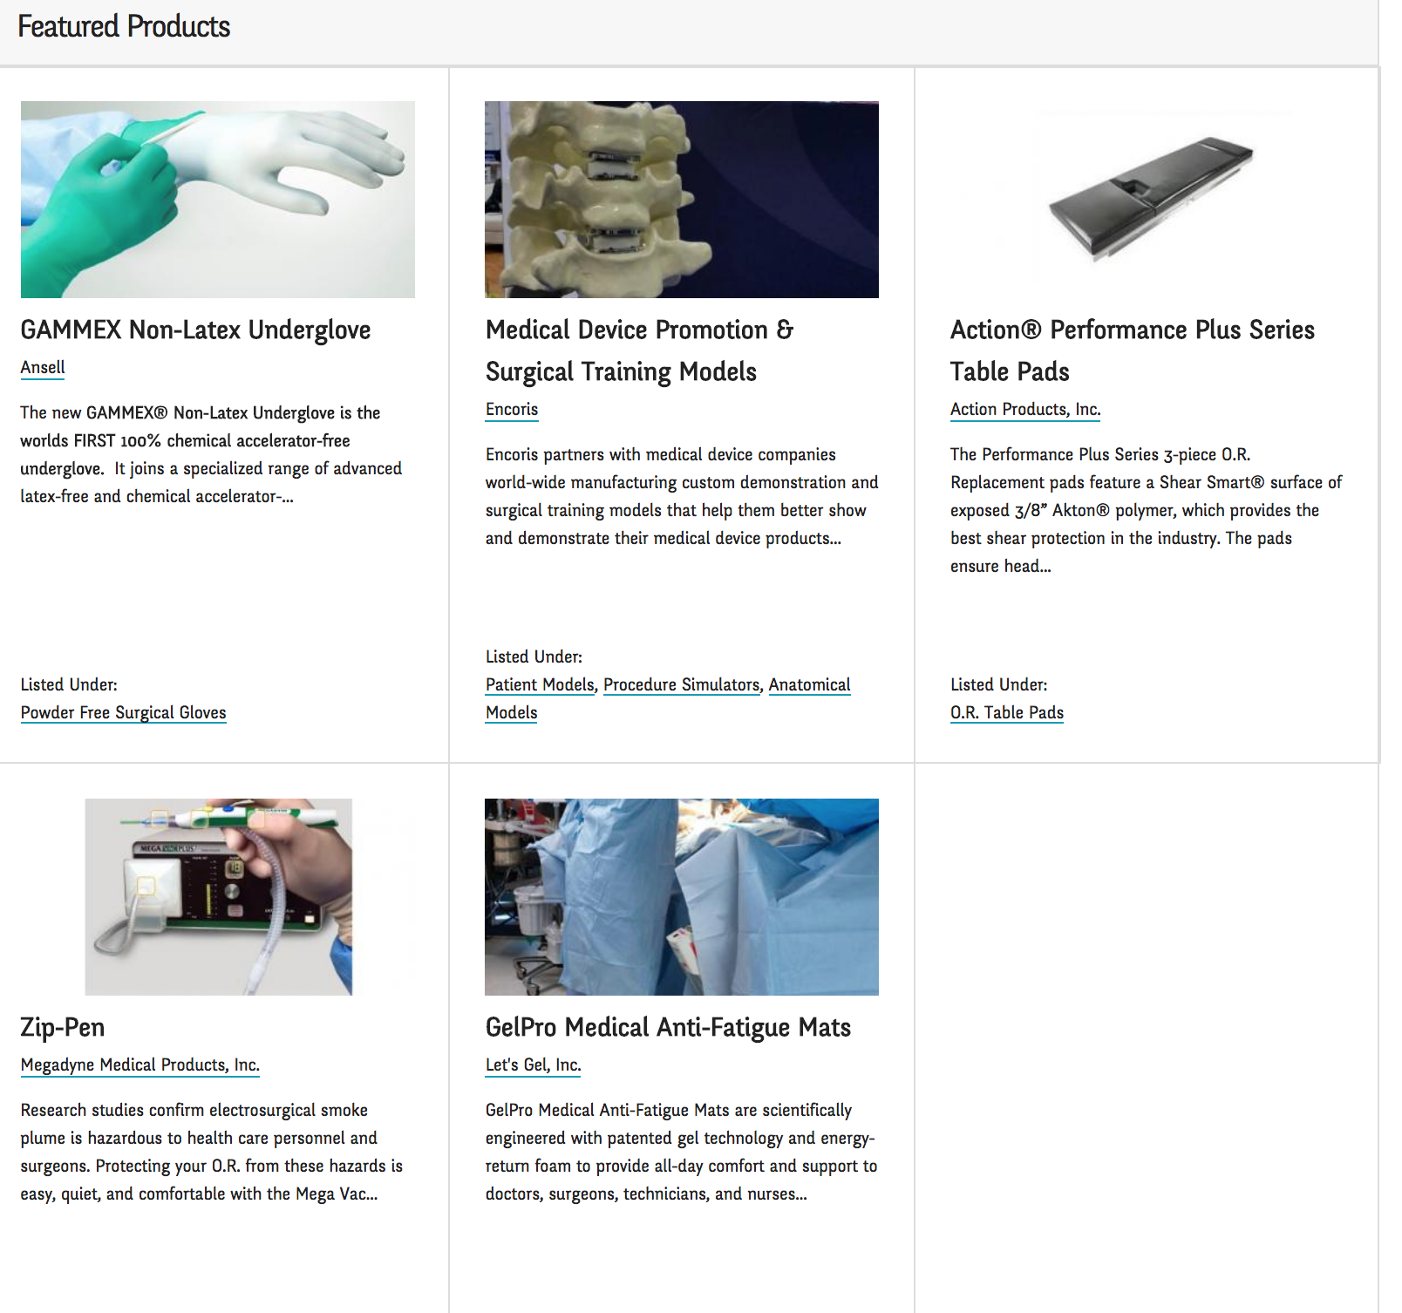
Trade Journals: Surgical Products Magazine
Surgical Products Magazine
Description:
An online medical device trade journals featuring
different categories of medical devices
Collection:
807 new products recorded from 2013 to 2015
Challenges
Not all products have company names

Slide 23
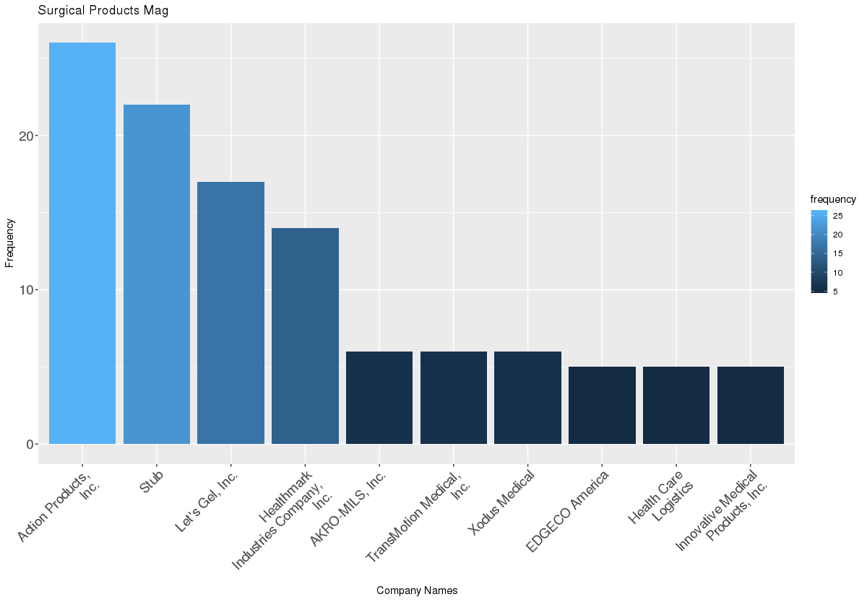
Trade Journals: Surgical Products Magazine
Analysis
Analyzed frequency of products by companies. Found
“Action Products Inc”, “Stub”, “Let’s Gel” are leading
companies

Slide 24

Trade Journals: Medical Design Briefs
Medical Design Briefs
Description:
An online medical device trade journals featuring
different categories of medical devices
Collection:
610 new products recorded from 2013 to 2015
Analysis
Analyzed frequency of products by companies.
Challenges
Inconsistency in formats

Slide 25
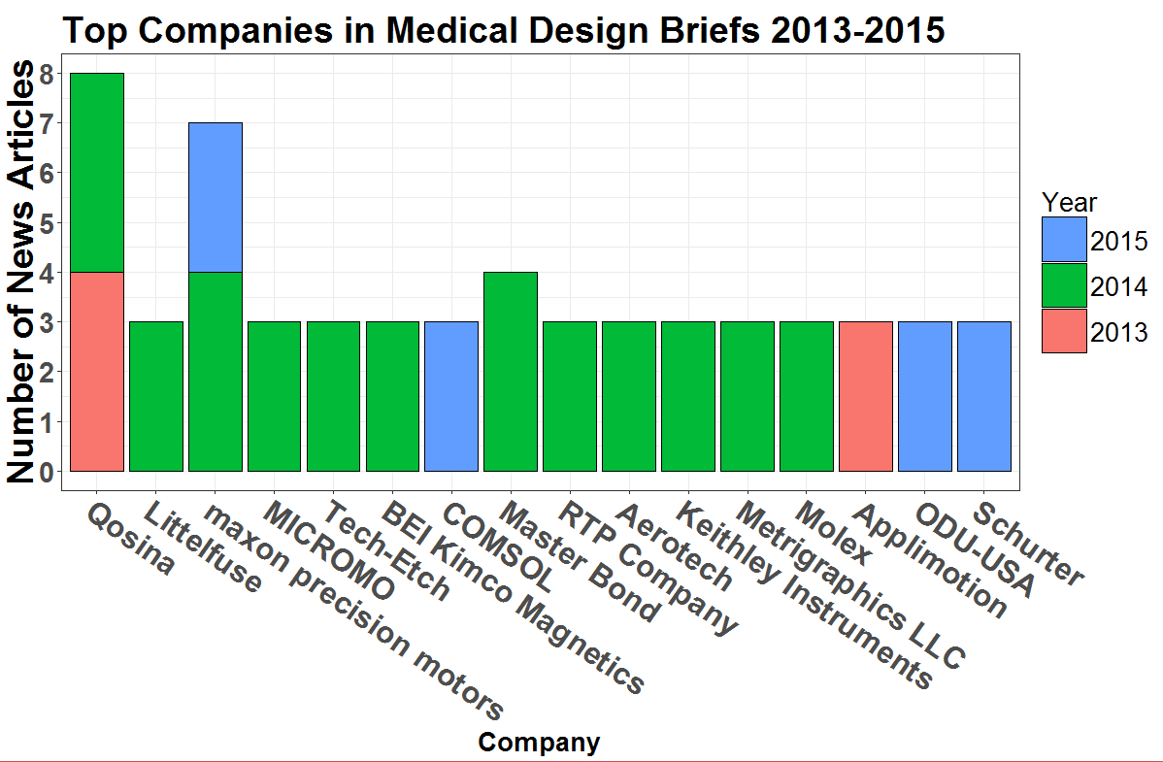
Trade Journals: Medical Design Briefs
Analysis
Analyzed frequency of products by companies by years. Qosina, Maxon Precision Motors and Master bond were the leading companies

Slide 26
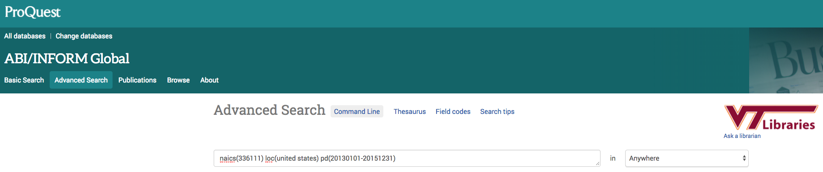
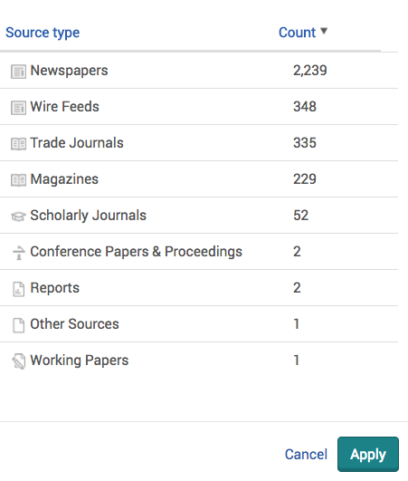
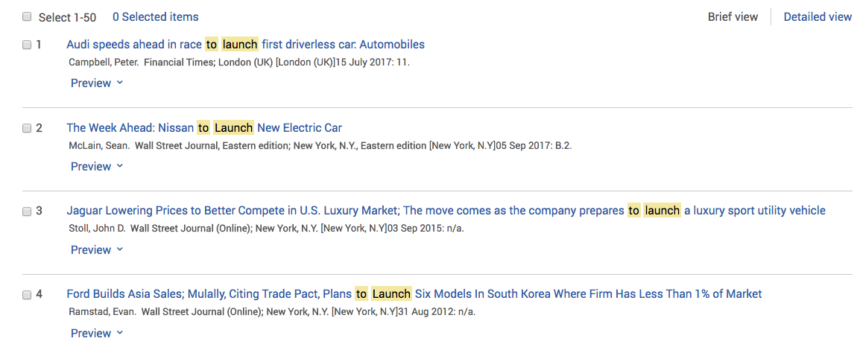
ProQuest

Slide 27
Example ProQuest Data
Data is organized by articles (i.e., each row is an article).
Data Element | Description | Example
Article Title | Title of the article | Chevy's Small Black: Story of a Remarkable Engine
Subject | Subject or subjects covered | Product design; Automobile engines
Company | Companies mentioned in the article | Name: General Motors Corp; NAICS: 333415, 336111, 336399
Publication Title | Where the article was originally run | Automotive Design & Production; Cincinnati
Publication Date | Date the article was originally run | 1/1/2013
Publication Subject | Subject of the publication | Business And Economics--Production of Goods And Services
Source Type | Medium for the publication | Trade Journal
Full Text | Full body text of the article | “This engine has gone through five generations…”

Slide 28
33911- Medical Equipment and Supplies Manufacturing
32541 - Pharmaceutical and Medicine Manufacturing
Source Type | NAICS 32541 | NAICS 33911
Magazines | 222 | 158
Newspapers | 2819 | 1489
Reports | 73 | 41
Scholarly Journals | 249 | 190
Trade Journals | 712 | 340
Wire Feeds | 156 | 170
These five digit codes were downloaded as six digit codes and aggregated up to the five digit level. These categories represent the six largest source categories provided by ProQuest.

Slide 29
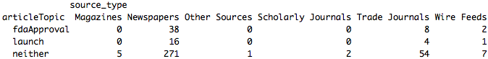
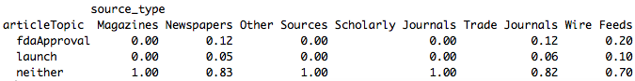
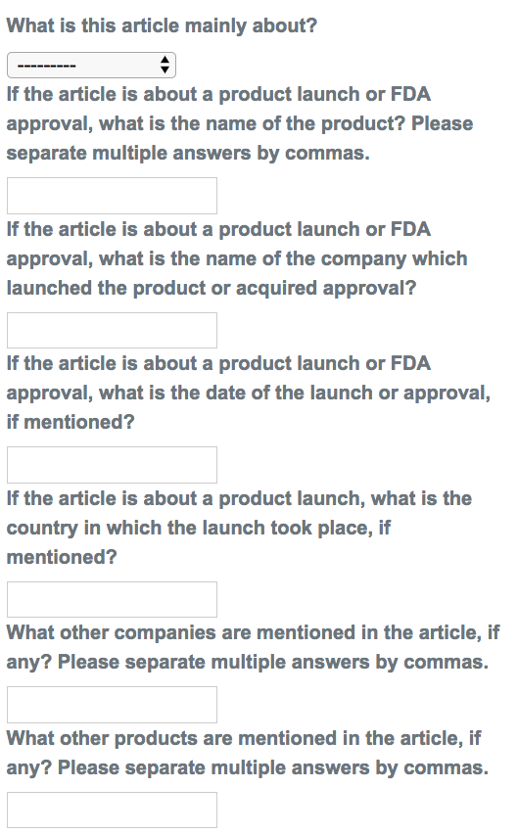
Labeling Exercise
These tables give counts of articles by topic and source type. The second table shows the proportion of each topic in each source type. For instance, 12% the articles from a newspaper were about FDA approvals.
Our summer students read and manually labeled 409 of the ProQuest articles
We asked them the questions to the left
Articles could be about a product launch, FDA approval, or neither.

Slide 30
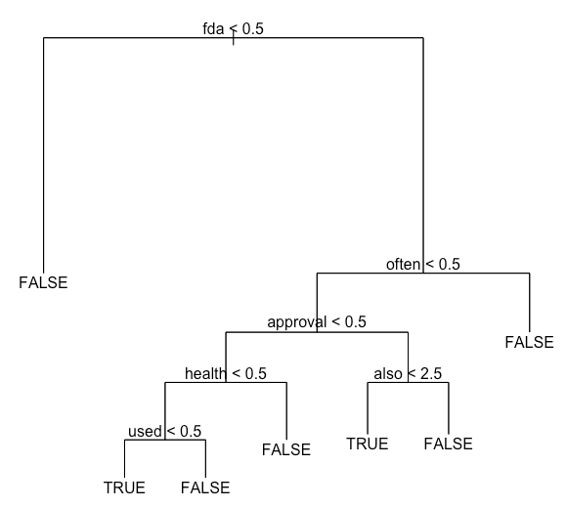
Method: Classification Tree
The classification tree groups articles into a set of bins depending on the word content of those articles and the way our students labelled them. Starting at the top of the tree, one moves left if the word appears fewer times than the given number and to the right if it appears more times. Once one makes it to the bottom node, predict that the article has the given value.
For example, if an article does not contain the word ‘fda’ move to the left and predict that it isn’t about a launch or approval. If it has fda at least once, check the word ‘often’, moving right if it has it at least once and left if it does not contain that word. Proceed until a terminal node is reached.
Question the tree answers: Is this article about a product launch or approval?

Slide 31
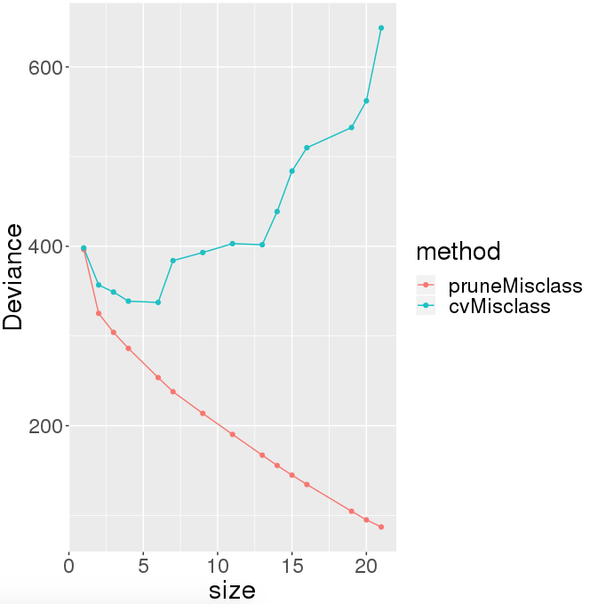
Method: Classification Tree Performance
 | Actual
Prediction | False | True
False | 399 | 24
True | 16 | 45
The size vs deviance plot was used to select a tree of optimal size.
While deviance always decreases with size in-sample, it decreases then increases again out of sample
The overall correct classification rate of the tree is 444 out of 484 (92%), compare to the always-guess-false classifier, which does 415/484 (86%)

Slide 32
Next Steps
FDA
Complete data analysis
Trade Journals
Conduct analysis on the body texts of each entry
Evaluate the quality of trade journals
ProQuest
Refine the ProQuest tree and use it to score unseen articles.
Read promising but unseen articles.
Consider alternative learning approaches and classifiers.
Comparison of Data Sources
evaluate the three data sources and see which one has the highest probability of mentioning new products

Slide 33
Measuring the Impact and Scope of Open Source Software (OSS) Innovation
PI: Gizem Korkmaz
Team: José Bayoán Santiago Calderón, Daniel Chen, Eirik Iversen, Hannah Brinkley, Keren Chen
Sponsor: Carol Robbins, National Science Foundation (NSF) National Center for Science and Engineering Statistics (NCSES)

Slide 34

Project Overview
Current NCSES and other economic indicators do not measure the value of open source software (OSS) outside the business sector:
Contribution of people from universities, government research institutions, nonprofits, and individuals
Importance of quantifying coding impact in the scientific community
Citations are used to measure the impact of patents and publications used to estimate research outputs
The goal is to test the feasibility and to develop methods to measure the impact and scope of OSS
Identify data sources and variables to measure attributes and economic value.
Notes:
We are analyzing the value of a scientific and artistic contribution that is not being accurately measured by current tools such as patents and citations.
We are developing a framework, methodology, identifying data sources and variables that are an improvement in this endeavor.

Slide 35
Research Questions
How much open source software is in use? (stock measure)
Active completed projects, downloads
How much is created each year? (flow measure)
New projects (annual and cumulative), lines of code, commits, man-hours
What types (categories) can be identified?
Who creates it?
Sectors: Business, Government, Academia, Households, Nonprofits, Foreign
Who benefits from its development?
Users: Downloads, citations, other developers (reverse dependencies)
What methods can we use to estimate cost and economic value of open source software?
Software cost estimation, network analysis
Notes:
Our research questions are pretty intuitive:
How much of it is out there (i.e., the stock)? Meaning projects with a production-ready release for the current environment.
How much is being developed every year (i.e., the flow)? We can identify this by various measures of activity.
What kind of projects are being developed?
...

Slide 36
OSS Definition
OSS is a computer software with its source code made available with a license in which the copyright holder provides the rights to study, change, and distribute the software to anyone and for any purpose.
OSS is a philosophical framework for how users should interact with software. It considers the rights to use, modify, and distribute it and under what conditions.
Operationalized
Open Source Initiative (OSI)-Approved License
Production Ready Release for Current Ecosystem
36
Notes:
Definition of OSS

Slide 37
Core Concepts
Current Focus:
OSS universe: how much is out there?
Profile of contributors (affiliations and sectors)
Contribution over time (rate of development)
Depreciation analysis
Strategy to capture OSS universe:
Three categories:
Major Projects (e.g., Mozilla, Apache)
Programming Languages (e.g., R and Python)
Packages (e.g., ggplot2, Pandas)
37
Notes:
What is being produced, by whom, where, when, and how?

Slide 38
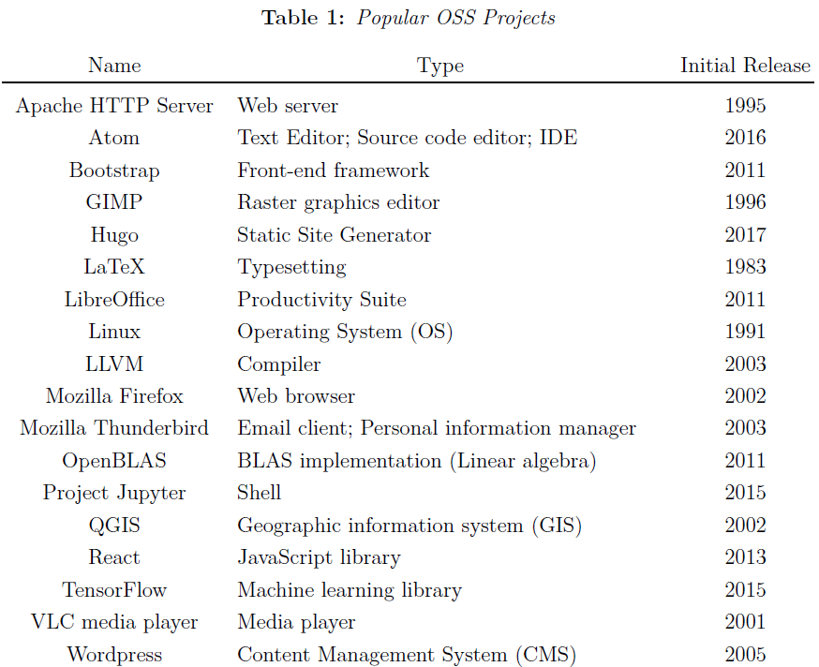
Notes:
major OSS languages
Hannah: witty comments on why these are great

Slide 39
Core Concepts
Strategy to capture OSS universe:
Three categories:
Major Projects (e.g., Mozilla, Apache)
Programming Languages (e.g., R and Python)
Packages (e.g., ggplot2, Pandas)
39
Notes:
Hannah
What is being produced, by whom, where, when, and how?

Slide 40
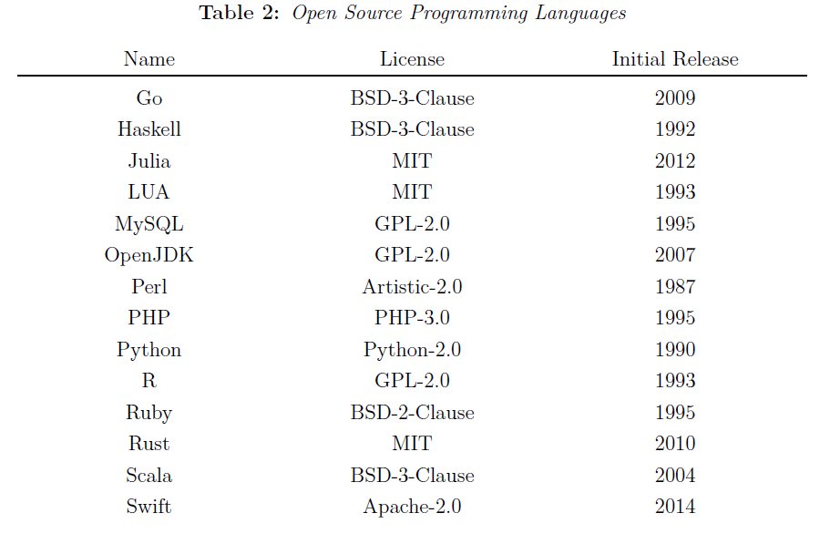
Notes:
Hannah

Slide 41
Core Concepts
Strategy to capture OSS universe:
Three categories:
Major Projects (e.g., Mozilla, Apache)
Programming Languages (e.g., R and Python)
Packages (e.g., ggplot2, Pandas)
41
Notes:
Hannah
Added functionality

Slide 42
Strategy
Registry
Manifest File
Repository
Common supported package managers
Contains basic information about each package
Contains Metadata
Author, license, version, dependencies, etc.
Some registries parse this information while others do not.
Information about the author, maintainer, license, package status, etc.
When Github is used
Additional information is provided
Contributions
Contributors
42

Slide 43
Data Collection
Usual Tools
GitHub API
Travis C.I. API
Licensee (Ruby Gem)
Tables
basic_information: (name, repository, status)
licenses: (name, license type)
authors: (name, entity, role, identity)
dependencies: (name, release, dependency)
contributors: (name, entity, lines of code (LoC), start_date, end_date)

Slide 44
Data Profiling
After examining 30+ different languages / package managers / registries we chose a subset most suitable for this project (see full inventory list).
Language | Package Manager | Number of Packages
R | CRAN | 12,614
Python | PyPi | 143,047
Julia | Pkg.jl | 2,040
JavaScript | CDNJS | 3,367
44
Notes:
1 started w/ 30+ …
2 created the inventory table w/ info about each pkg managers such as… (eg. size, talk about the table briefly)
3 selected these 4 commonly used langs, will collect the info about all pkgs in these 4 langs, (and u can see the #pkgs in 3rd column)
we will collect development activity information, contributors, etc.

Slide 45
Next Steps
Project Code (Github)
Validate Data
Analysis
Collect the contributions and contributors.
For the latest release
For the top 100 contributors by commits
Timestamped Lines of Code (LoC)
Profile of contributors
License
Package status
Continuous Integration (C.I.)
Maintainers
Activity
Estimate cost and value (by organization, sector, category, language)
Network analysis of contributors and packages
Dependency charts

Slide 46
Virginia Tech
Student Lifecycle Metrics
PI: Aaron Schroeder
SDAL Leads: Gizem Korkmaz & Sallie Keller
SDAL Team: Devika Nair, Jay Warajuntano, Doug Mattingly, Davon Woodard
Sponsor: Ken Smith, Vice Provost of Virginia Tech

Slide 47
Agenda
Research Questions
Project Plan
Research Areas
Admissions
Progression
Next Steps
47

Slide 48
Research Questions
Using the new Virginia Tech Data Lake and other available to create new metrics to measure student success in the areas of:
Admissions
How do students respond to acceptances?
What patterns accompany students who choose to enroll elsewhere?
Student Success
How do students perform throughout their 4 years at Virginia Tech?
What patterns characterize students struggling to complete their studies?
48

Slide 49
Admissions
Patterns for Alternate Enrollment
Finance
The Expected Family Contribution
Location
Community Demographics
High School - College Goingness
Family Education History
School Chosen Factors
School/Program Ranking differences
Size/type
Distance difference
Realistic tuition difference
Rural vs. Urban
Method | Target | Example Independent Variables
Logistic Regression | Accept/Decline | Degree Program Ranking + Tuition
Multinomial logistic regression | School Selected | Distance + Scholarship status

Slide 50
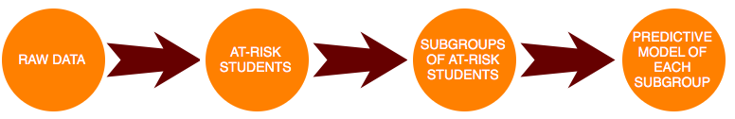
Progression
Patterns for Student Success
Factors of Interest:
Goal Measure:
Graduation Rate
Retention from year to year
Embeddedness
Greek life
Intramurals
Student athlete
Hokie Camp
Learning Community
Background
Community Characteristics
High school - College Goingness
First generation
Finance
Unmet need
Data Analysis Methods:
Logistic Regression
Decision Tree
Stepwise Regression

Slide 51


Overall Data Sources
Internal
University Data Commons
Post-Secondary Trajectory Model (SDAL)
External
State Council of Higher Education for Virginia (SCHEV)
Virginia Department of Education (VDOE)
National Student Clearinghouse
American Community Survey (ACS)
College Rankings (US News)

Slide 52
Project Plan & Next Steps
Deadline: July 15
Variable Adjustments
Transforming variables
Creating new variables
Linking data
Deadline July 31
Modeling
Prediction generation
Subset comparisons
Deadline: August 5
Presentation
Poster Preparation
Presentation Practice
Deadline: June 30 (TBD)
Data
Quality Review
Fitness Evaluation
Identification of key identifiers
Approach
Topic Selection
Method Selection

Slide 53
Questions?

Slide 54
VCE Dashboard
Midpoint Presentation
PI: Aaron Schroeder
co-PIs: Stephanie Shipp, Brian Goode, Daniel Chen
Team: Devika Nair, Cory Kim, Luke Kim
Sponsor: Michael Lambur, Associate Director, Virginia Cooperative Extension

Slide 55
Agenda
Project Goals
Progress
Research Areas
Natural Resources
Emergency Risk Areas
Community Resources
Project Plan & Next Steps
55

Slide 56
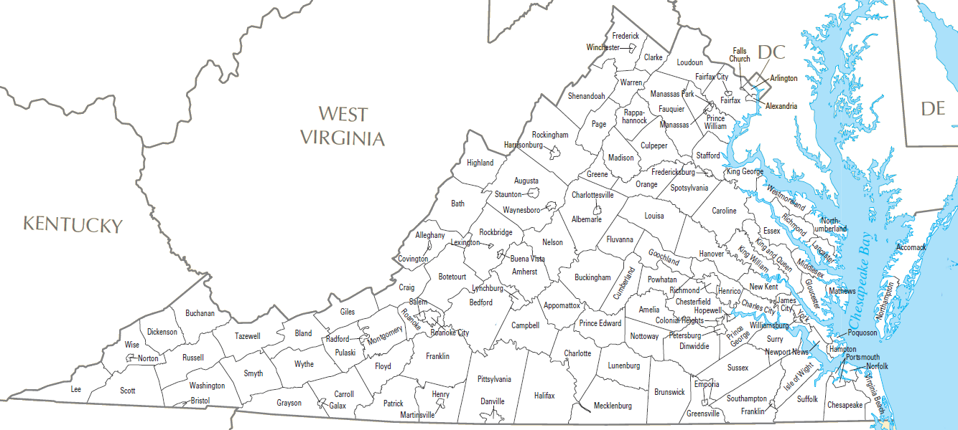
Project Goals
Goal:
To better inform county extension agents about their jurisdiction by providing sub-county level data.
Target Information
Natural Resources*
Emergency Risk Areas
Community Resources
Dashboard

Slide 57
Progress
Data Exploration
EPA - air quality, radon
MSHA - mining conditions
NRCS Geospatial Data - soil survey
USGS - water quality
Data Acquisition Methods
Web Scraping - rvest, XML, JSON
Data Packages - SoilDB
SQL database storage
GIS Packages - sp, sf, raster

Slide 58
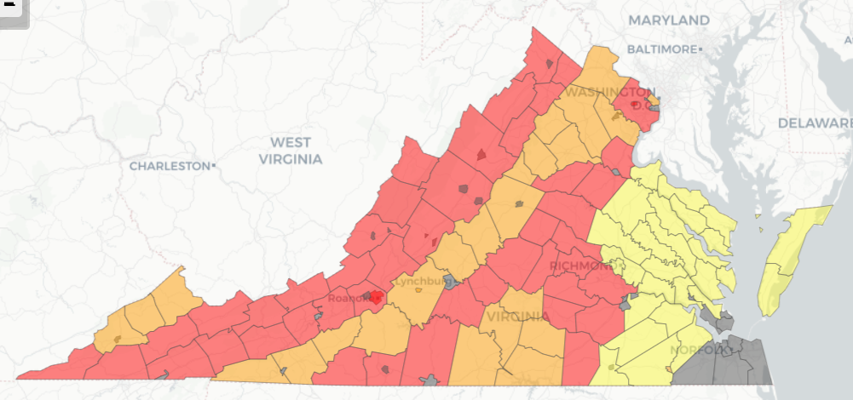
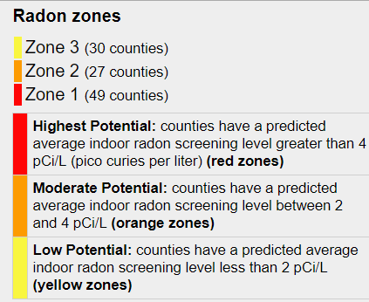
Radon
Data:
Sourced from EPA
County level detail
Allocating value to block groups
Definition: radioactive gaseous element produced by the decay of radium: emissions are a health hazard, substantially increase the risk of lung cancer.
Picocuries - 1/1,000,000,000 (one trillionth of a curie)
curie - measurement of radioactivity level

Slide 59
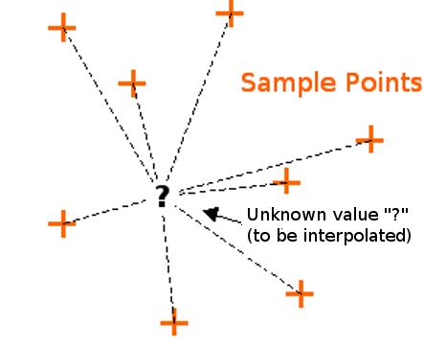
Air Quality
Air Quality Index (AQI)
Measured from Ozone, Sulfur Dioxide, Nitrogen Dioxide, Carbon Monoxide, and PM_{2.5}
Data source: EPA
Method of Transformation: Inverse Distance Weighting
Centroids from Census Block Groups
Notes:
AQI is an index of air quality obtained using 5 pollutant measurements ranging from 0-500. High AQI is hazardous so it is important to show our sponsors which areas of Virginia are susceptible to public health crises. We obtained AQI data from EPA monitors and will join that data with centroids of census block groups. Because not every block group has monitors, we have to approximate the AQI using the Inverse Distance Weighting method.

Slide 60
Project Plan & Next Steps
Phase I - 6/20
Soil
Radon
Water Quality
Air Quality
Mining
Land Cover
Phase III
Dashboard **
Additional Datasets (time permitting)
Coastal Health
Commute Times (Drive, Walk, Transit)
Residential Density
Traffic Volumes
Connectivity
Biodiversity
Wineries
Bees
Phase II - 7/20
Housing
Flooding
Fire
Social Service (Travel Times)
Crime Data

Slide 61
Questions?

Slide 62
ARI2: How Embeddedness of
Army Enlisted Soldiers
Affects Job Performance
PI: Josh Goldstein, Vicki Lancaster, Stephanie Shipp
Team: Megan Grondine, Kelsey McMahon, Emily Sheen
Sponsor: Kelly Ervin, Joel Thurston, Nathaniel Ratcliff,
U.S. Army Research Institute (ARI)

Slide 63
Outline
Project Overview
Summary of Literature
Deep dive of 12 installations
Data Discovery
Data Exploration
Next Steps

Slide 64
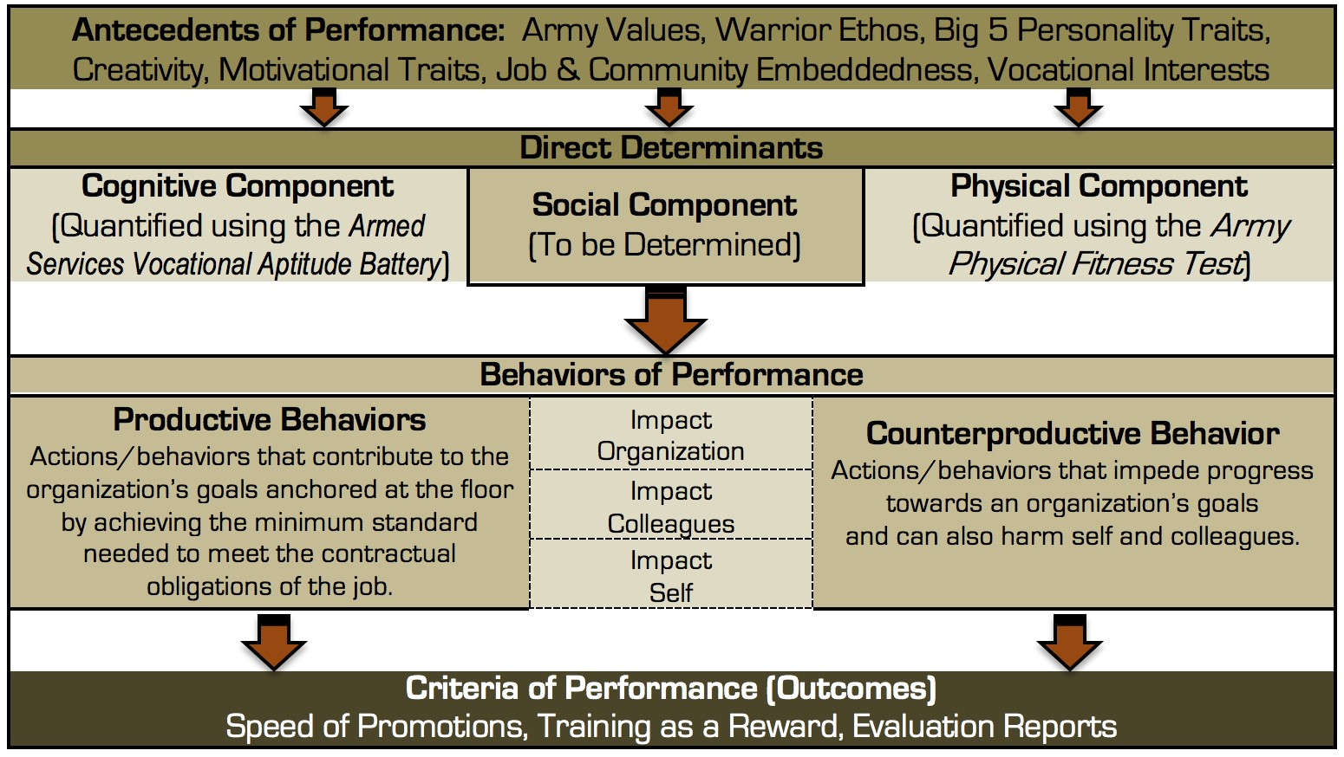
Project Overview
Problem Statement: To understand how embeddedness in an Army installation and the surrounding community affects the social component of Soldier performance.
Notes:
social component is what we are focusing onThere are many aspects of a soldier and his lifestyle that can affect their performance at work. We are interested in the job and community embeddedness part. Specifically, we are focusing on the social component.
Why this is important: within the US Army, there is increasing interest in understanding how physical, cognitive, and social behaviors drive Soldiers to successfully meet the challenges of a world in persistent conflict. SDAL’s focus is on examining the social component of Soldier performance. We’re curious how external influences might affect the Soldier’s performance at work. A Soldier’s performance at work can positively or negatively affect themselves, their colleagues and the organization. As you notice, performance is evaluated through behavior. Productive behaviors contribute to the goals of the organization. Counterproductive behaviors can harm the organization’s goals, as well as the Soldier and/or his or her colleagues. The performance outcomes we are evaluating in this project are speed of promotions, training as a reward, evaluation reports, court martials, and honors and rewards.

Slide 65
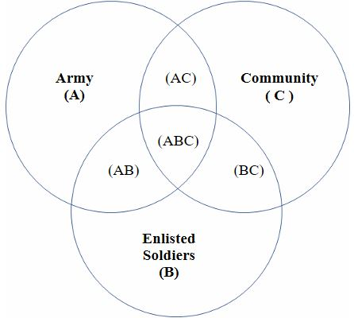
Literature Review
Job Embeddedness
Fit, Connections & Links, Sacrifices
(Holtom)
Conservation of Resources Theory
(Kiazad)
Predicts Performance
Community Embeddedness
Family, friends, church, vol. groups
Area wealth & equity; opportunity
Job Performance
“Behaviors relevant to goals of org.”
(Campbell)
Task, contextual, adaptive performance
(Koopmans)
Counterproductive work behaviors
Families &
Notes:
We started with an extensive literature review of embeddedness and what it means to be embedded in your job versus your community and how that affects your job performance.
job embeddedness is when the job fits into your life, you have connections inside and outside of the job, and there are sacrifices if you leave (for example: losing friendships in the area, losing job perks, or your spouse having to quit their job in order to move with you)
Community embeddedness is important to us because within our lit review, one author, Kiazad, stressed that employees are highly embedded in their jobs if they are highly embedded outside of the job as well - this entails church groups, volunteer groups, sports, etc
Job performance is defined by another author, Campbell, as “behaviors or actions that are relevant to the goals of the organization” and when embeddedness is improved, it is believed that performance improves.
We wanted to show this Venn diagram to represent that a soldier can be embedded in the community within the army without being embedded in the organization itself and that distinction is relevant to the data that we are collecting because we want to ensure that we understand what exactly soldiers are embedded into.

Slide 66
Data Discovery
Installation Profiles
Researched representative sample of 12/120 military installations around the U.S.
Publically available data sources
County Health Rankings - overall health data
Simply Analytics - popular data, business data, location data
IPEDS - postsecondary education data: # colleges in surrounding county
NCES - public & private elementary through high school in US
US Geological Survey - Geographic Data, parks & protected land
ACS - from last year’s ARI profiling project
Notes:
Add green sources

Slide 67
What impacts Soldier performance?
Family Variables
Coverage under health insurance
Spousal Employment opportunities
Welfare
Drugs & Alcohol
School quality for kids
School opportunities for spouse
# children
Community Variables:
Social associations
% of people who vote
Access to exercise opportunities
Job opportunities
Educational opportunities
Excessive drinking
Alc. impaired driving deaths
Mental health
Violent crime
Housing & transport issues
Food environment index
Community
(county)
Family
Soldier
Soldier Variables
Marital Status
Income
Welfare
Children
Army
At the installation level, we have data from the ARI on soldier performance measures, including:
Court martials, promotions, honor & rewards, training as a reward, evaluation reports
Notes:
So we really wanted to make sure we dissected what impacts soldier performance.
The soldier is what we want to focus on there in the center and as you can see there are the three other variables that the soldier is involved with: Community, Family, and the Army and below this Venn diagram it has the Installation as a separate variable, which includes factors like court marshalls, promotions, and rewards.
So, Family variables are going to be thing things that directly impact the life of the soldier: coverage under health insurance, spousal employment opportunities, welfare, etc. These are important because if the soldier’s family does not have a good quality of life at the base, embeddedness drops.
Community Variables are those that are affecting the soldier from the outside. This is data from the neighborhood/county level of the area the soldier has to move to. This is likely to affect soldier performance because of the opportunities and activities they have when they are living on the installation. If there are fewer activities, then the soldier is less likely to become embedded.
As for the Soldier variables; we want to address these individual level soldier variables, but all the data we have access to is higher level. The lowest level of data is Community level, so we are able to get the overall amount of married men as opposed to another base but not how being married affects a soldier’s performance.

Slide 68
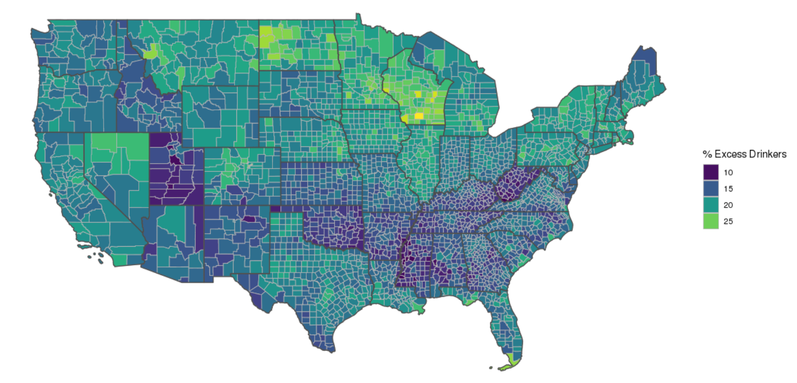
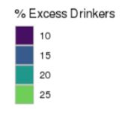
Data Exploration
Notes:
Emily: This plot shows percentage of excessive drinkers by county in the US, pulled from the County Health Rankings dataset.
Our project aims to characterize the installations and surrounding counties using meaningful indicators for quality of life and embeddedness.

Slide 69
Next Steps
July 11 - August 9
Exploratory data analysis – descriptive statistics and visual summaries of Army installations and communities.
Exploratory analysis of the effect of community profiles on some measures of performance – summary measures pulled from the PDE (e.g. Article 15 punishments, courts martial, promotion schedules).
Creating a data product that combines multiple public data sources to characterize Army bases and communities, e.g. adding to the dashboard or using another approach.
Notes:
So, for our next steps, we are going to first do some more exploratory data analysis. We are going to get more descriptive statistics and use those to create visual summaries to add to the dashboard that was created last year. The dashboard is currently very extensive from last year’s project but when we add the community data it allows us to understand our problem through a community-embeddedness lens, because last year worked less with individual community data.
Next, we are going to explore the effect of the community profiles on performance using the PDE, which is the installation data that we don’t have yet; it stands for Person-Event Data Environment. That is going to help us receive more information on performance as opposed to embeddedness so we can assess how they affect one another.
Finally, we plan to create a data product that combines public data sources to characterize army bases and communities.

Slide 70
Questions?

Slide 71
Midpoint Presentation for the Roanoke Valley-Alleghany Regional Project
Sponsor: Wayne Strickland, Director, Roanoke Valley and Alleghany Regional Commission
Team: Davon Woodard, Eirik Iversen, Cory Kim, and Doug Mattingly
PI: Stephanie Shipp, co-PIs: Vicki Lancaster and Josh Goldstein

Slide 72

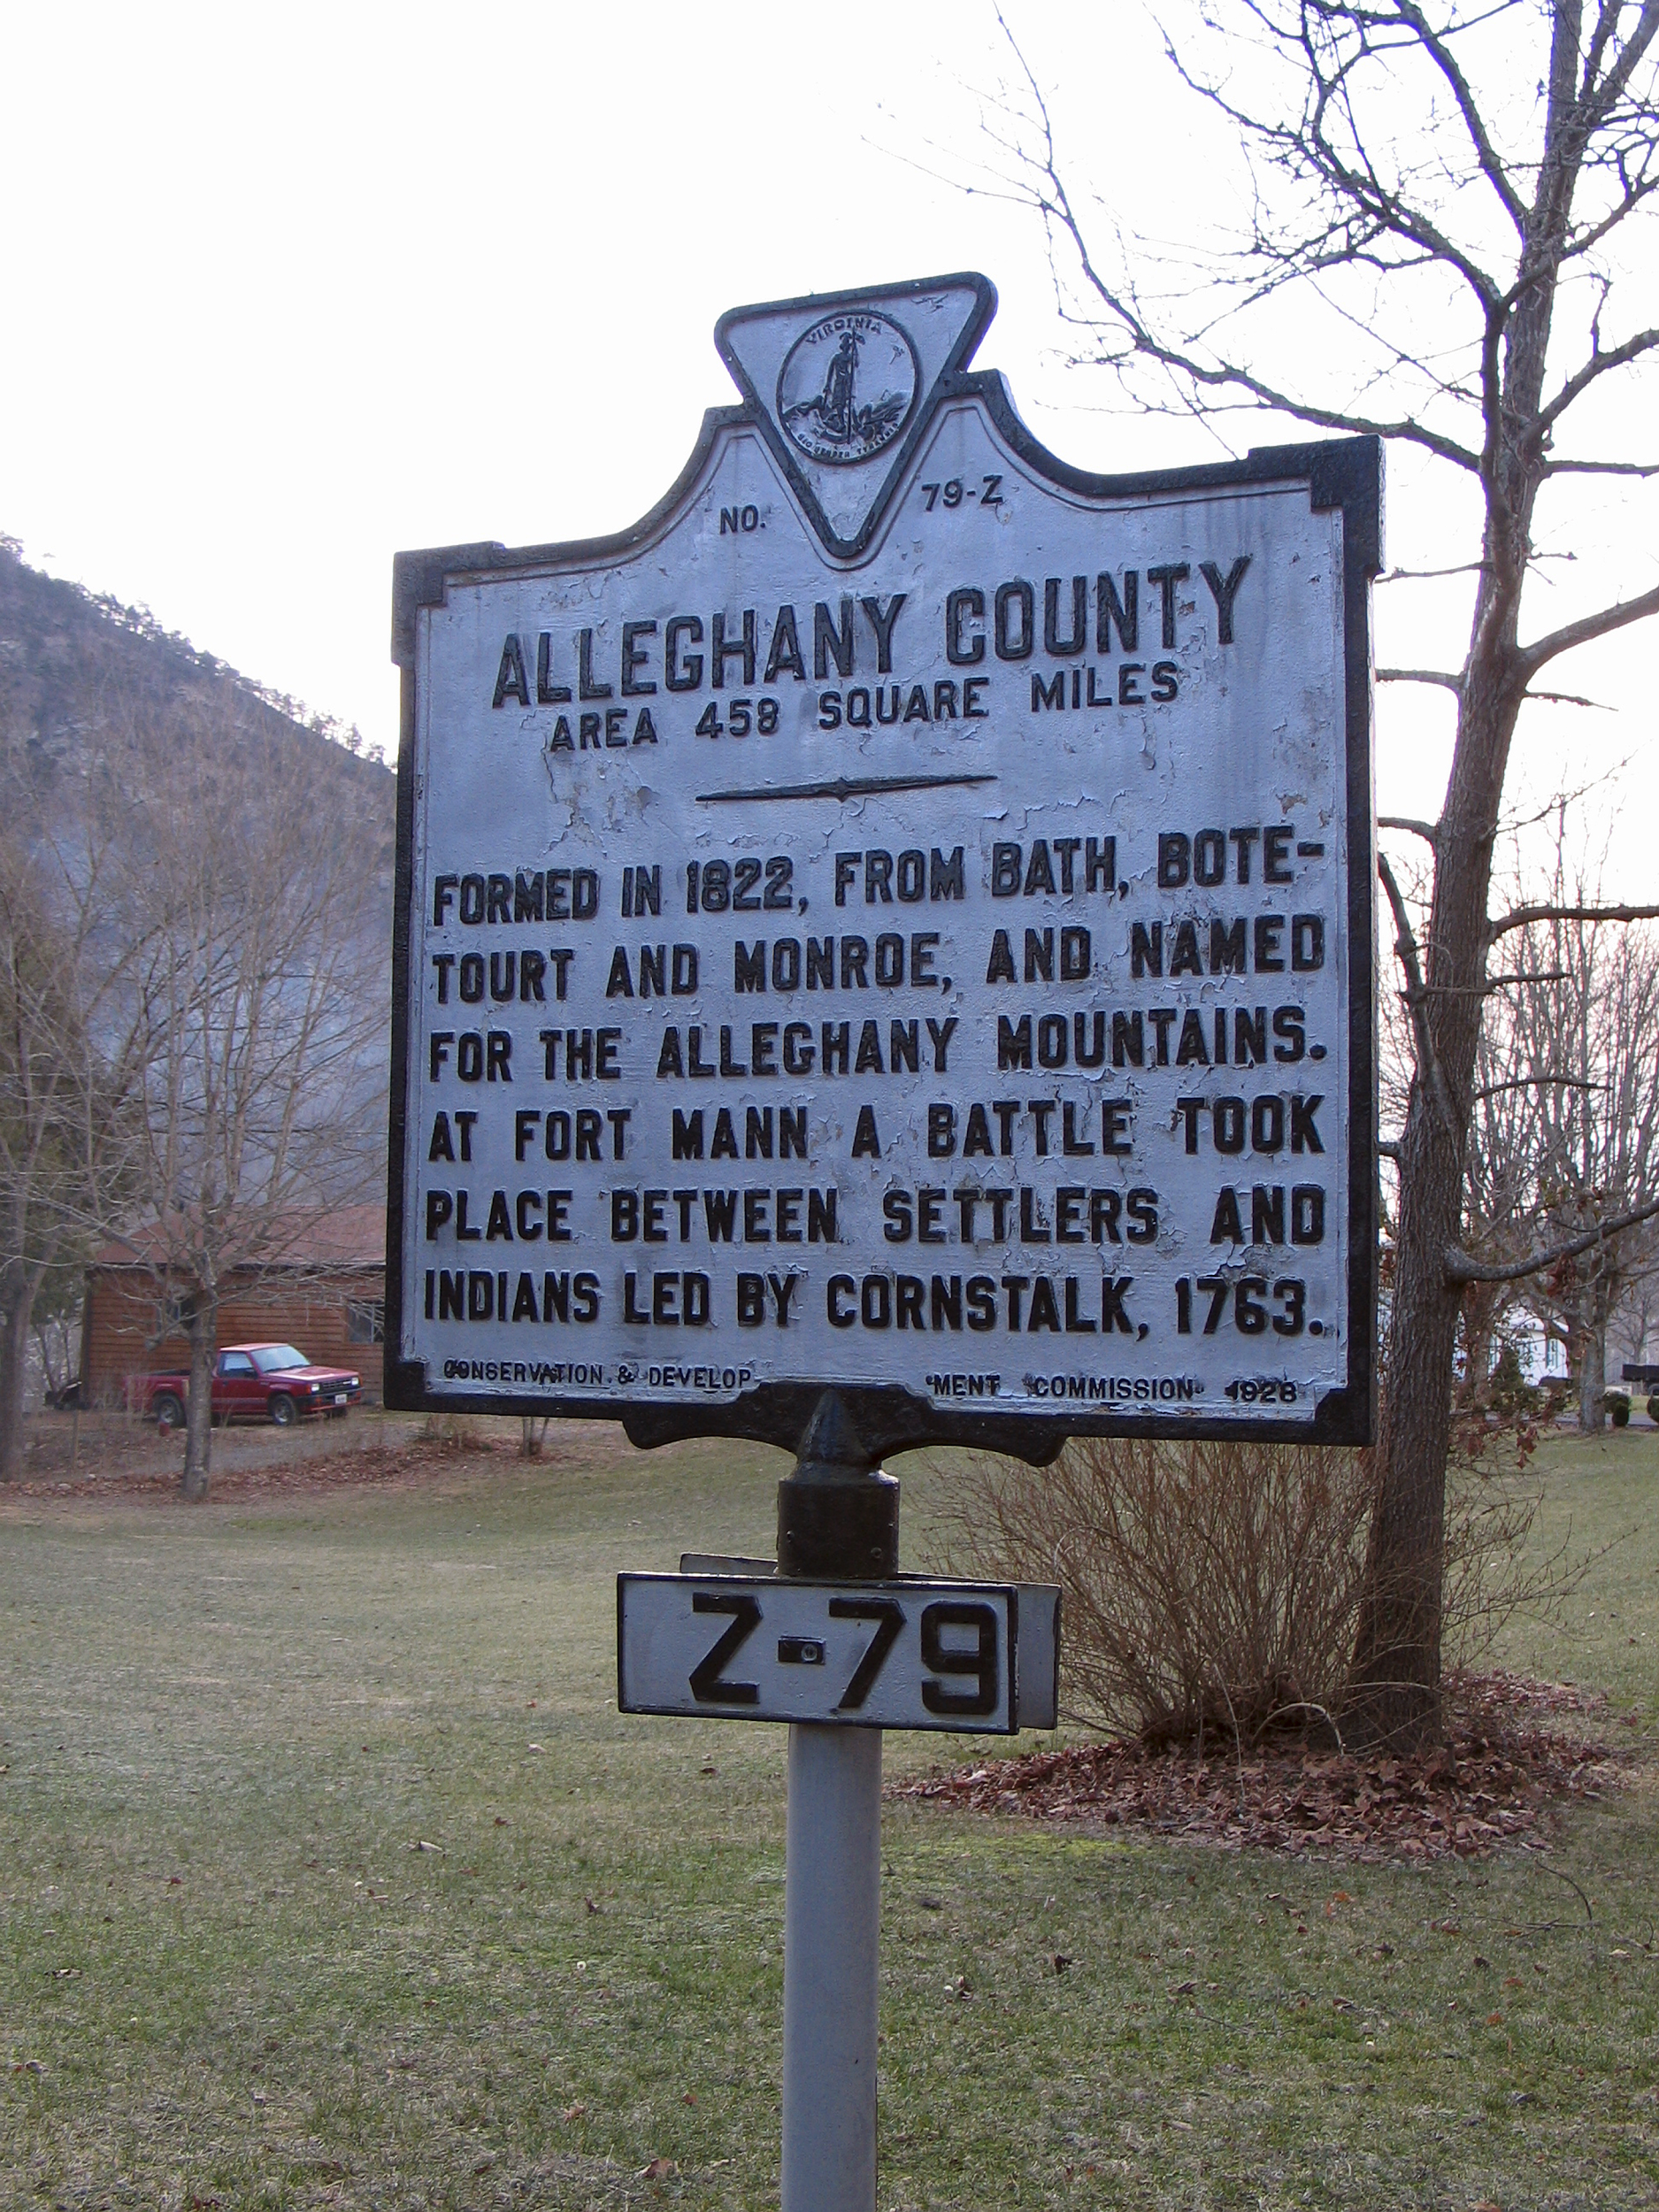
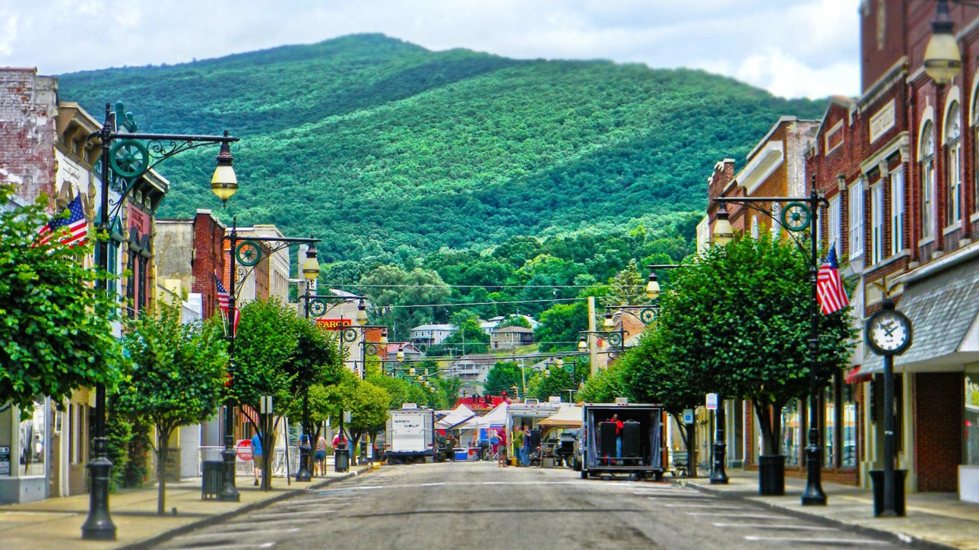
Project Goal(s)
SDAL plans to create community-scapes for the Roanoke Valley-Alleghany Region which align with the Commission goals and show whether the region is meeting their goals.
Community-scapes are social, economic, health, and well-being indicators at the sub-city or sub-county (neighborhood) levels.
For this project, our partners, include:
Virginia Tech- Maggie Cowell
Global Forum on Urban and Regional Resilience - Jim Bohland
Hollins University - Jon Bohland

Slide 73
Community Indicators
Economic Development
Workforce
Development
Healthy
Roanoke
Natural
Assets
Unemployment
Median Income
Housing Burden
High School Graduation Rate
Available Jobs
Food Insecurity
Primary Care Providers
Obesity
Air Quality - PM25
Air Quality - Ozone
Greenways

Slide 74
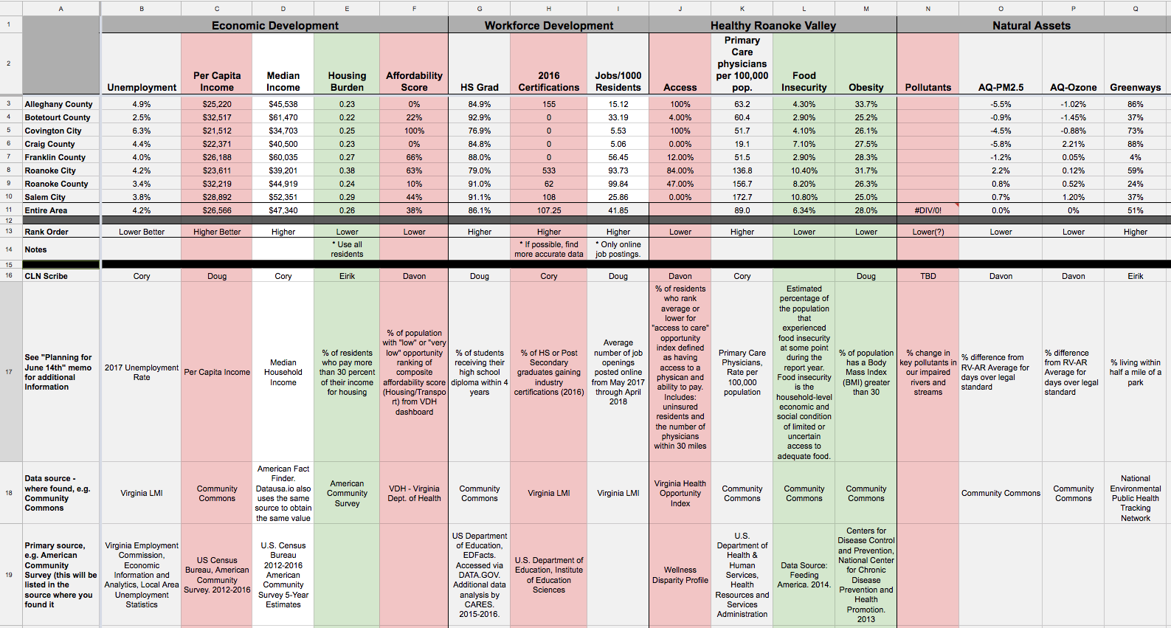
Indicator Worksheet

Slide 75
Roanoke Valley - Alleghany Regional Facts
RV-AR Region
Access to Parks:^{[5]}
2010: 24.8%
2015: 51.3%
Change: +107.2%
Population:^{[1]}
2010: 330,749
2017: 334,781
Change: +1.2%
HS Graduation Rate:^{[2]}
2012: 91%
2017: 92.1%
Change: +1%
Percent designated as food insecure:^{[1]}
2010: 10.8%
2016: 11.0%
Change: +1.8%
Percent Unemployment:^{[4]}
2010: 8.01%
2017: 4.3%
Change :-46.0%
Top 5 Employers:^{[4]}
Franklin County School Board
M.W. Manufacturers
County of Franklin
Trinity Packaging
Ferrum College
Obesity Rate:^{[6]}
2010: 28.9%
2014: 28.7%
Change: -0.5%
Median Income:^{[1]}
2010: $48,087
2016: $47,855
Change: -0.5%
Sources: [1] American Factfinder; [2] Virginia Department of Education; [3] Community Commons; [4] Virginia Labor Information; [5] National Environmental Public Health Tracking Network; and, [6] RWJF County Health Rankings
Notes:
Population should be total for entire region.
Top 5 employers - should both public and private

Slide 76

Qualitative Analysis for Each County and City Covington as an Example
Covington city is the county seat of Alleghany County.
Covington city’s top 3 employment industries are:^{[14]}
Manufacturing
Retail Trade
Health Care and Social Assistance
In fact, the City has been attracting 21st century jobs such as manufacturing in hope of increasing employment opportunities.^{[12]}
There is a primary care physician for every 52 patients.^{[14]}
Recently, the Covington School Board has been looking to close a $150,000 budget gap.^{[11]}
Notes:
Manufacturing source: http://www.ahedc.com/wp-content/uploads/images/2018/06/Governor-Northam-Announces-31-New-Jobs-in-the-City-of-Covington.pdf

Slide 77
Data Facts for Each County and City - Covington City as an Example
Covington
City
Access to Parks:^{[5]}
2010: 27.8%
2015: 73.7%
Change: +165%
Population:^{[1]}
2010: 5,961
2017: 5,531
Change: -7.2%
HS Graduation Rate:^{[2]}
2012: 92.8%
2017: 90.6%
Change: -2.4%
Percent designated as food insecure:^{[1]}
2010: 10.94%
2016: 16.8%
Change: +53.6%
Percent Unemployment:^{[4]}
2010: 10.6%
2017: 6.3%
Change: -40.6%
Top 5 Employers:
Alliance Group Rock Tenn
WalMart
Ingevity Virginia Corporation
Covington City School Board
Garten Trucking, LC
Obesity Rate:^{[6]}
2010: 29%
2014: 28%
Change: -3.5%
Median Income:^{[1]}
2010: $35,277
2016: $34,703
Change: -1.6%
Sources: [1] American Factfinder; [2] Virginia Department of Education; [3] Community Commons; [4] Virginia Labor Information; [5] National Environmental Public Health Tracking Network; and, [6] RWJF County Health Rankings
Notes:
Population should be total for entire region.
Top 5 employers - should both public and private

Slide 78
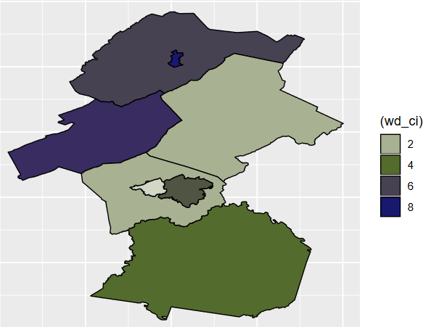
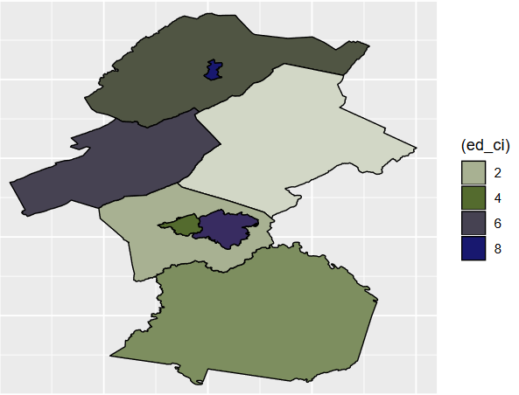
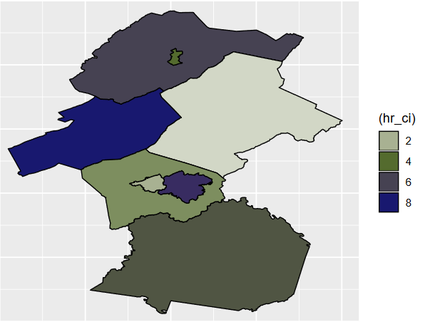
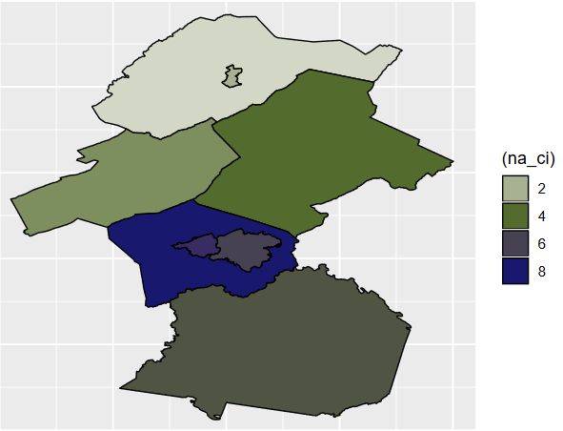
Composite Indicators
Natural Assets
Economic Development
County | Composite Indicator Rank
Botetourt County | 1
Roanoke County | 2
Franklin County | 3
Salem City | 4
Alleghany County | 5
Craig County | 6
Roanoke City | 7
Covington City | 8
Workforce Development
Healthy Roanoke

Slide 79
Next Steps - Focus on Workforce Development
Topics
Next Steps
Increasing attractiveness of RVAR
Attracting people currently not in labor force, e.g. early retirees, those who have used drugs, prisoner re-entry, recent university graduates Match or mismatch of job skills to job vacancies
Improving job supply and demand match
Providing Transportation options
Improving Housing quality
Other
Literature & report review
Data discovery
Accessing GIS shapefiles
Geocoding locations of businesses and transportation routes
Creating synthetic ACS data
Describing issues through the data
Creating indicators by neighborhoods, e.g. attractiveness, job match, other

Slide 80
Internal Labor Force
REGIONAL ATTRACTIVENESS
External Labor Force
Community Characteristics (HH):
Park Access (EPH/CDC)
Walkability Score (Search web)
Housing Age (ACS)
Housing Affordability
rented vs owned (ACS)
Cultural Base (Web Search)
Challenges:
Drug Usage (CDC, Web Search)
Prisoner re-entry (ACS)
Childcare cost (Web Search)
RV-AR
RV-ARC
Cities and Counties
Households
Transportation:
Public
Commute times (LEHD)
Personal
% Car ownership (ACS)
% Walking, biking, public transit (ACS)
Labor Force
(actual/potential)
Community Characteristics (Industry):
HS, College Grad (VLMI,VDOE)
Job Quotient (BLS)
Workforce
Development
Industry
Workforce Development:
Certifications (IPEDS)
High school workers
Company Engagement (Community Colleges, High Schools)
Primary Ed. Ratings (IPEDS)
Roanoke Valley-Alleghany Region (RV-AR)

Slide 81
Questions?

Slide 82
Arlington Equity Project
Sponsor: Community Progress Network
Team: Davon Woodard, Armi Mosavian, Jay Warajuntano
PI: Vicki Lancaster

Slide 83
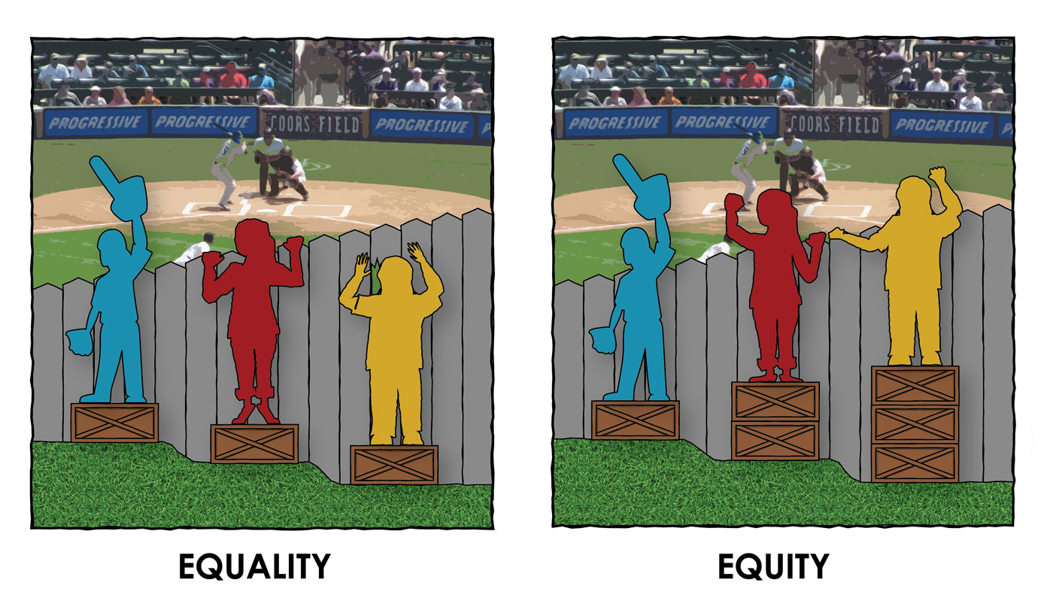
Equity vs. Equality
WHAT IS EQUALITY?
WHAT IS EQUITY?
Equality is treating / allocating resources equally
Equity identifies the disadvantaged by unmet needs for resources and services (Wang and Mastracci 489)
“The pursuit of equality is to say citizen A being equal to citizen B… (whereas) equity is to say adjusting shares so that citizen A is made equal with citizen B” (495)
Notes:
Bullet 1. If people stay in Arlington County, one of the benefit is shorten the time of commute.
However, Bullet 2
I gather the data through American Community Survey from 2009 to 2016.
Bullet 4. Moreover, the data indicates that

Slide 84
Affordable Housing
Affordable housing is encouraging people to live in Arlington County
House and rental prices are rising, while new home starts are decreasing.
Data Used: American Community Survey 2009-2016 “Price Asked”
Numbers in this dataset represent the number of houses available in the market in different price range in Arlington County.
Notes:
Bullet 1. If people stay in Arlington County, one of the benefit is shorten the time of commute.
However, Bullet 2
I gather the data through American Community Survey from 2009 to 2016.
Bullet 4. Moreover, the data indicates that

Slide 85
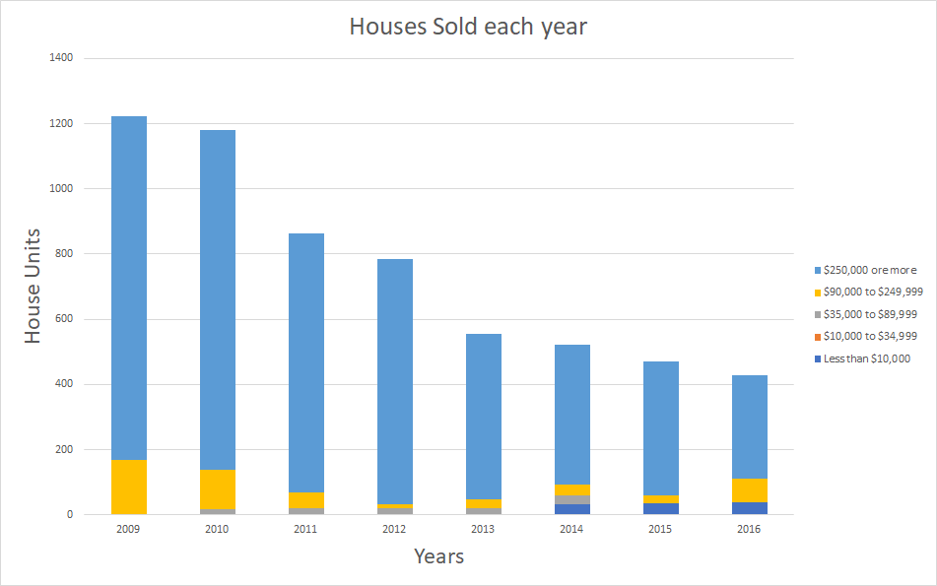
Affordable Housing
American Community Survey 2009 - 2016 Data, Price Asked
Notes:
As you can see, the houses at the price of $250,000 or more are constantly sold.
Moreover, the total amount of sold house is decreasing.
Comparing this price range to the rest, it indicates that a cost of living in Arlington County is high. Due to the high cost of living, it might discourage people to live in this area.
what price range can we should consider to be affordable to buy or rent in this area?
what
Would be interested to compare the price of buying houses and renting apartments with other counties and within the zip code area of Arlington County?

Slide 86
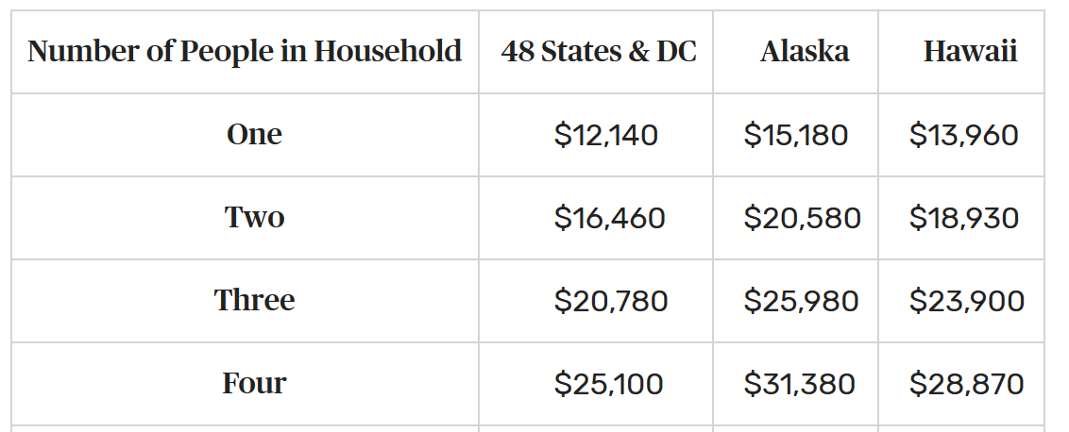
Arlington County Middle Class
Income to Poverty Level Ratio
Inclusive growth for Arlington County includes the economic advancement of the middle class
This ratio compares income levels against the the Federal poverty level.
Healthcare.gov, 2018; Community Commons 2018

Slide 87
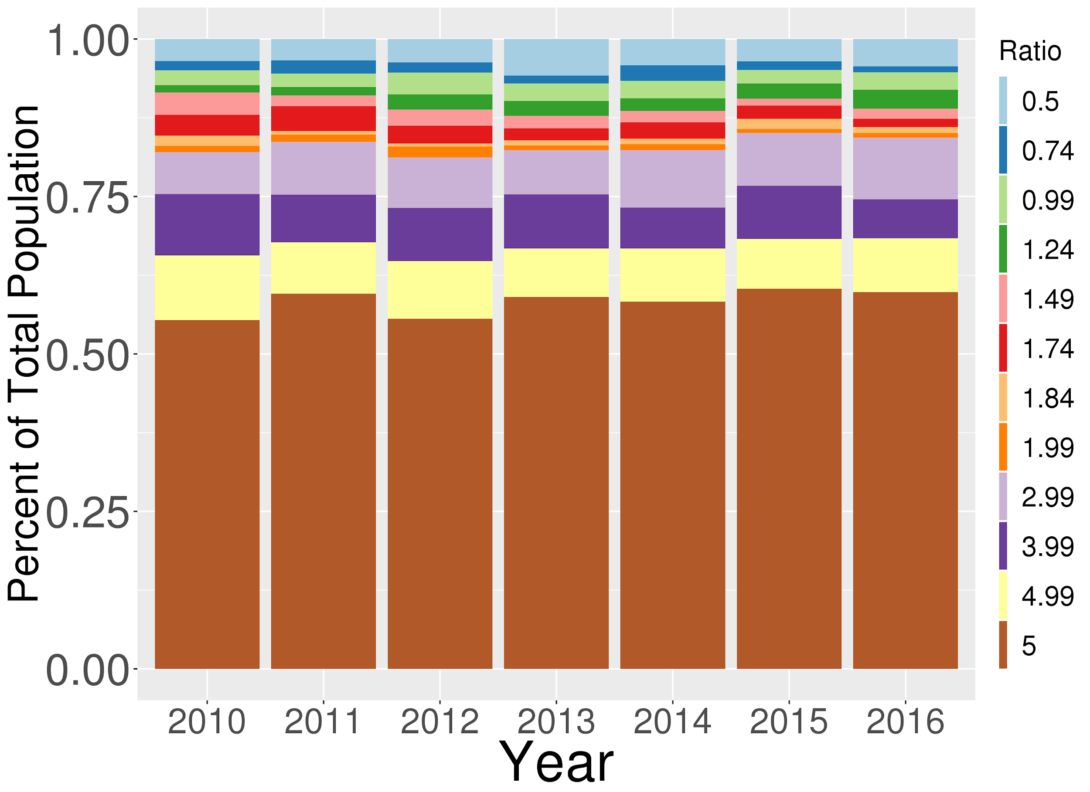
Arlington County Middle Class
American Community Survey (ACS) years 2010-2016 “Ratio of Income to Poverty Level in the Past 12 Months (ACS 1 Year Estimates”

Slide 88
Earnings and Wages
The ability of Arlington County residents to earn a sufficient wage underpins the impacts of available housing, and the middle class.
The initial research question was to understand the changes in local industry composition and worker earnings to better understand access to housing and the change in the middle class
Coupled data from 2006-2016 American Community Survey Data and Bureau of Labor Statistics.

Slide 89
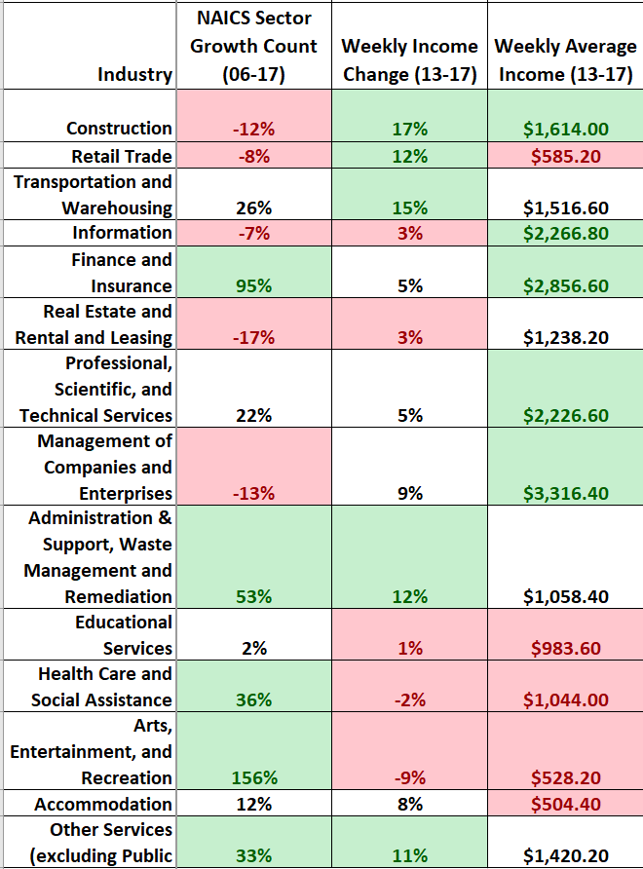
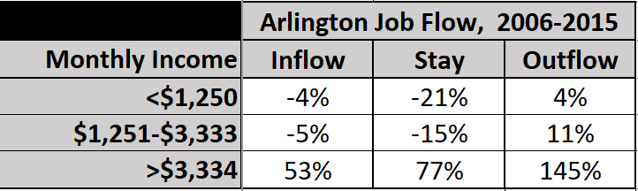
Earnings and Wages
Bureau of Labor Statistics NAICS High Level, 1 Area; On the Map
Notes:
As you can see, the houses at the price of $250,000 or more are constantly sold.
Moreover, the total amount of sold house is decreasing.
Comparing this price range to the rest, it indicates that a cost of living in Arlington County is high. Due to the high cost of living, it might discourage people to live in this area.
what price range can we consider to be affordable to buy or rent in this area?
Would be interested to compare the price of buying houses and renting apartments with other counties and within the zip code area of Arlington County?

Slide 90
Next Steps:
By the next quarterly CPN meeting describe the state of housing inequality in Arlington:
Measures will describe inequality at two levels:
At the county Level:
Does Arlington provide sufficient jobs to support rental prices?
If lower & middle class households paid 30% of their household income on housing how much more of their income would be available to spend in their community?
Based on household incomes in Arlington, what would the distribution of rental prices need to be in order for a household to spend no more than 30% of their household income on rent.
What are the eviction rates?
B. At the census block group or neighborhood level:
Where do the lower & middle class households with housing burdens > 30% live?
In these communities, is there access to affordable healthy food?
In these communities, is there access to transportation?
2. Provide a summary of the results of the equity survey

Slide 91
Questions?

Slide 92
DHS Record Linkage Phase II
PI: Ian Crandell
Team: Aaron Schroeder, Fangfang Lee, Keren Chen,
Sponsor: Michael-dharma Irwin, Arlington Department of Human Services (DHS)

Slide 93
Objectives
Overall Goal
Create effective linkage between four different data systems for the Department of Human Services (DHS) in Arlington & discover unique clients
Improve from last year’s progress
Tasks:
Implement deterministic deduplication in each system on social security number (ssn) before passing the result to probabilistic deduplication and linkage
Explore effective geocoding/address parsing options
Create machine learning algorithms that automate the linkage process while optimizes the cutoff for linking/deduplication

Slide 94

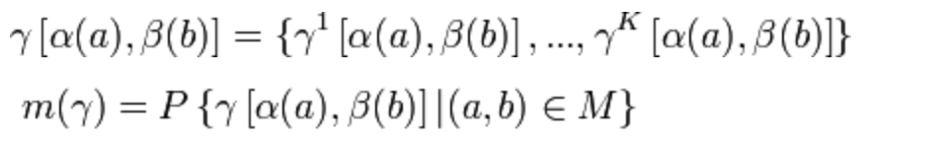
Method
Deterministic Linkage: if two fields do not match exactly, label as not a match
Probabilistic Linkage:

Slide 95
Data Sources
 | Anasazi | ETO | WVS | HCV (New)
Columns | 44 | 37 | 33 | 37
Rows | 56533 | 25775 | 64927 | 4347

Slide 96
Workflow
Prepare and format new data
Parse Address and Geocode
Deduplication within each individual data system
Deterministic Deduplication
Probabilistic Deduplication
Linkage across four systems
Build predictive models

Slide 97
New Dataset--HCV
Stages
Preparing data
Geocoding/Address Parsing
Deduplication (deterministic/probabilistic)
Combining datasets
Progress
Selecting columns to work with:
customer IDs
customer personal information
customer residential information
voucher & staff information
Data Standardisation
97

Slide 98
HCV Results
Started with 37 columns, now have 23 columns, may end up with fewer columns
Standardisation
Separated DoB columns into 3 columns
Race columns 1-5 → a single race column
Address Columns → a single address column
Unified data format & column names
NA rows: 0
DoB in the future: 0
Invalid SSN: 181
98

Slide 99
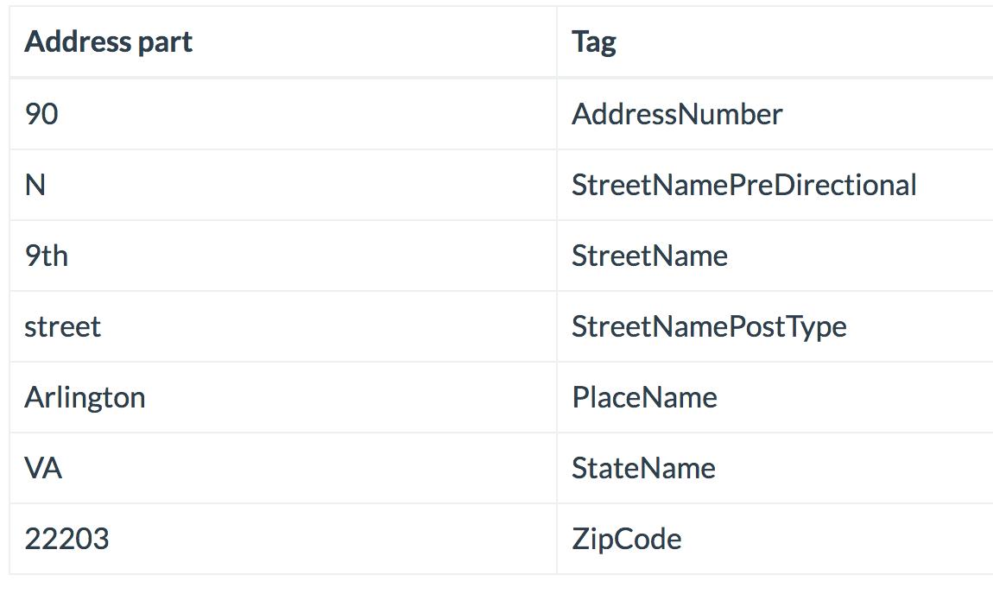
Address Parser/Geocode
Background: full addresses provided by the sponsors are in unparsed form. We need a secure, private, and inexpensive way to parse the addresses in order to pass them in deduplication and linkage.
Methods: Python address parser package (https://parserator.datamade.us/usaddress)
Results : Parserator performs comparably with google map API (statistics forthcoming)
Example:
full_address = { 90 N 9th street, Arlington, VA, 22203 }
99

Slide 100
Deterministic Linkage
Background : In order to improve from last year’s probabilistic linkage, we are adding deterministic deduplication on SSN in each system prior to probabilistic deduplication.
Results
ETO
Size: 25775 observation, 37 columns
Observation with SSN: 18307
Observations without SSN: 7467
After deduplication: 17871
ANZ
Size: 56533 observation, 44 columns
Observation with SSN: 28968
Observations without SSN: 27555
After deduplication: 28705
WVS
Size: 64927 observation, 33 columns
Observation with SSN: 15525
Observations without SSN: 49402
After deduplication: 11308

Slide 101
The ‘Lucy’ Problem
Problem: Occasionally, records that appeared distinct in a single data source would be collapsed when we joined data sources:
WVS
ETO
First Name | Last Name
Lucy | Ball
Lucille | Square
First Name | Last Name
Lucille | Ball
Solution: Originally we thought the problem was a calibration of the linkage weights. However, the true problem was an application of deduplication as opposed to linkage.
101

Slide 102
Next Steps
Pass finished deterministic deduplication to probabilistic deduplication
Link records across four human services systems (combining all four systems and identify unique clients)
Create machine learning algorithm that automates this process
Finds optimal cutoffs to avoid type I error (linking across individuals incorrectly) and type II error (failing to link same individuals incorrectly)

Slide 103
Alcohol-Related Crime Reduction Strategies for Restaurants and Nightlife in Arlington (ACPD)
PI: Gizem Korkmaz
SDAL Team: Aaron Schroeder
Team: José Bayoán Santiago Calderón, Hannah Brinkley, Alexa J. Nosal, and Kelsey McMahon
Sponsor: Jim Mastoras, Arlington County Police Department
Notes:
Hannah
This is the Alcohol-Related Crime Reduction Strategies project led by Gizem Korkmaz and Aaron Schroeder. This project is sponsored by Jim Mastoras from the Arlington County Police Department.

Slide 104
Introduction contd.
“The Police Department’s Arlington Restaurant Initiative was designed to address public safety issues, foster relationships and cooperation with businesses, and ultimately raise the best standards of restaurants that serve alcohol. The goal of the initiative is to develop strategies that will maintain Clarendon as a safe destination for nightlife and entertainment” (2017 Annual Report the Arlington County Police Department).
Best Bar None Goes to Arlington
TIPS (Training for Intervention ProcedureS): a skills-based training program designed to prevent intoxication, underage drinking, and drunk driving.
Partnership with Washington Regional Alcohol Program to offer free rides home via ride-sharing services.
Notes:
Hannah

Slide 105
Project Goals
Problem: evaluate effectiveness of ARI in regards to economic and social impact
Alcohol Related Crime types: drunkenness, DUI, public disorder, etc.
Our focus: heaviest drinking times in Clarendon
Thursday, Friday, Saturday, Sunday
between 9PM - 3AM
Notes:
Hannah

Slide 106
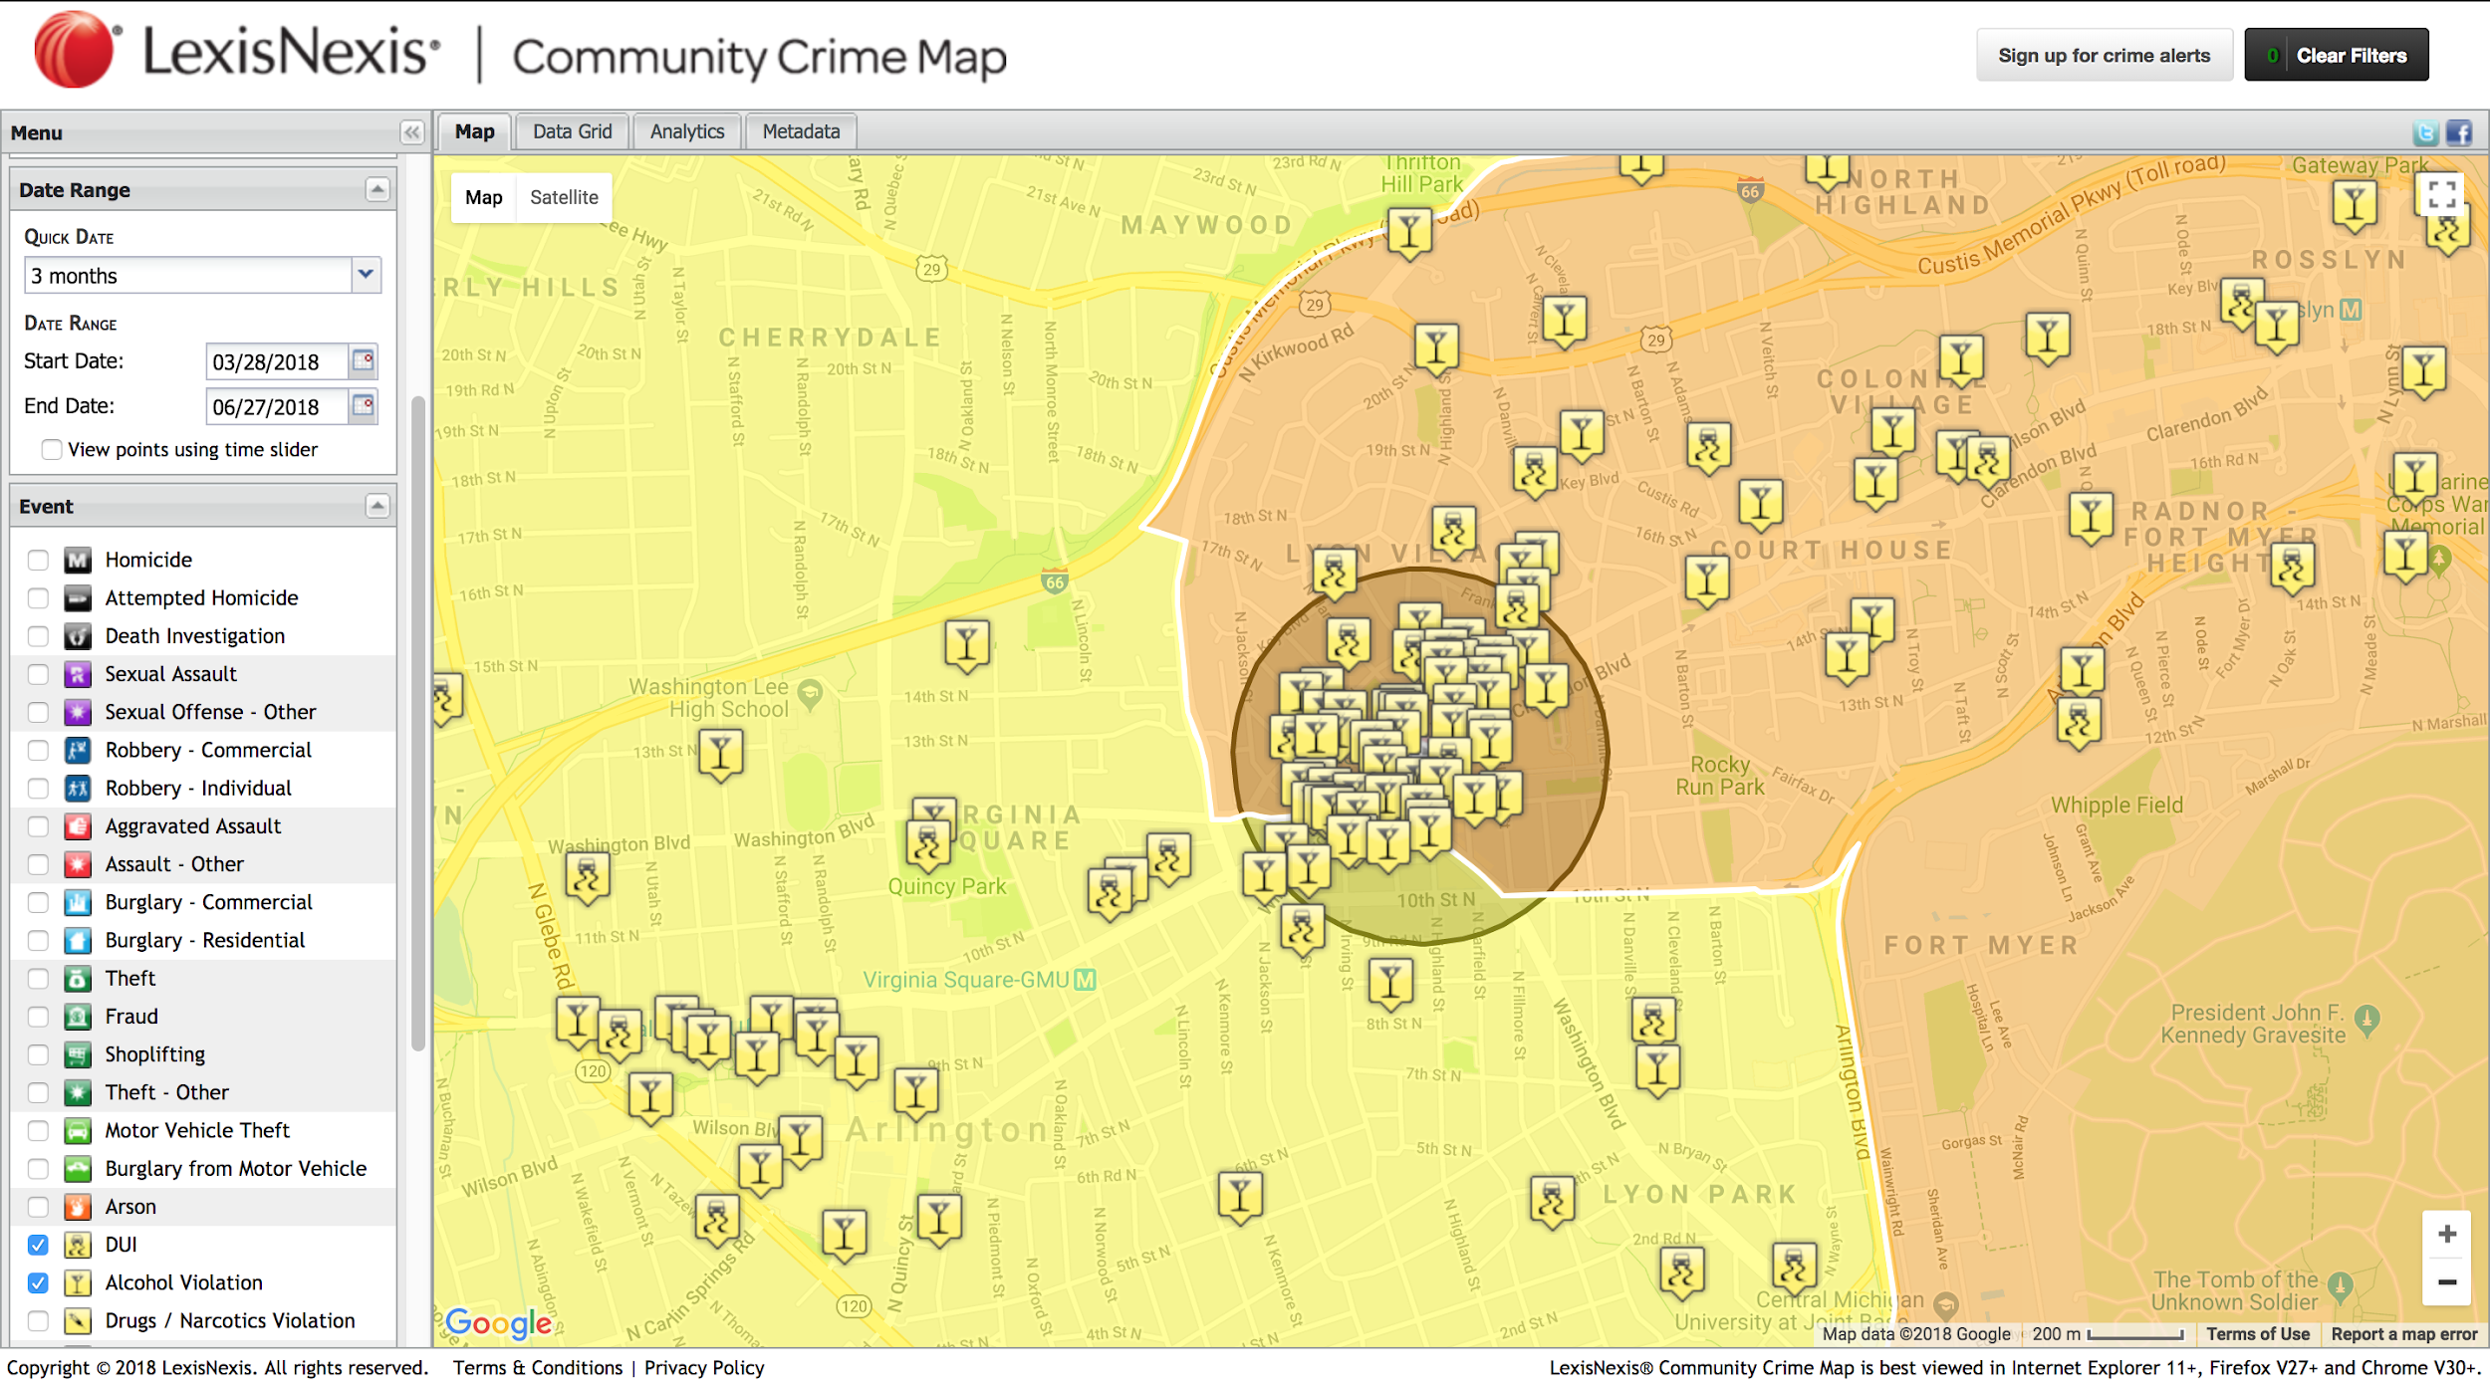
Notes:
Bayoán
We selected the Clarendon Metro Station as the centroid and based on the distribution of alcohol related crimes and police district boundaries decided to consider a quarter mile buffer as the area of interest.

Slide 107
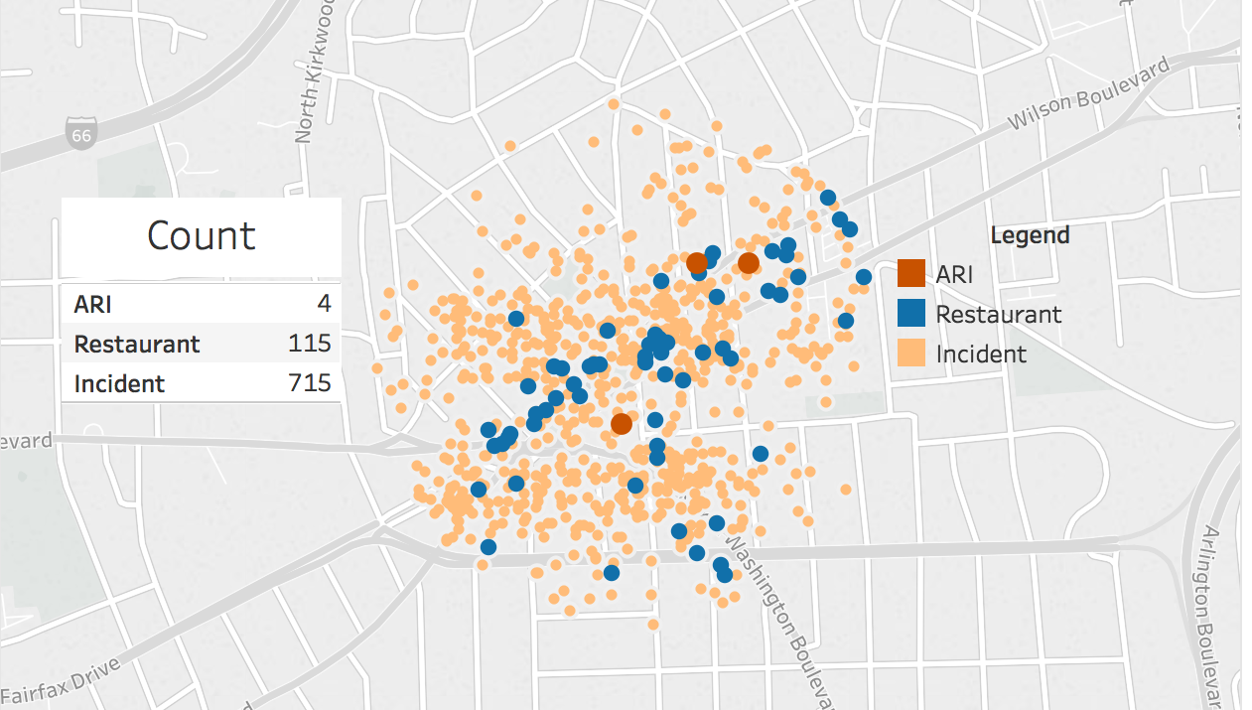
Crime Data & Restaurants
Notes:
Bayoán

Slide 108
Social & Economic Impact Analysis
Social Impact Analysis (SIA)
Captures the effects of policy and regulations on people’s behavior, decisions, quality of life, and community
Better relationship with police (relationship-focused policing)
Community involvement
Safer for residents
Less crime
Economic Impact Analysis (EIA)
Captures the effects of policy and regulations on economic factors such as housing values, average median income, and business revenues
Return on Investment
Reduces likelihood of the restaurant losing their liquor license
Increased sales
Less crime: Avoid arrest, jail and court fees
Both can inform future regulatory actions or interventions based on positive or negative impacts of the policies already implemented (Before & After)
Notes:
Alexa
in order to address the effectiveness of the ARI program, we also need to consider the social and economic impacts
SIA---how the program will impact citizens quality of life in Arlington, example increasing safety during nightlife
-this analysis began last year in the Urban Affairs and Planning Class at Virginia Tech under Dr. Zhang
-her students collected data on other alcohol control programs to begin to make a framework
EIA---How has property tax and sale price been changing?
If safety is increasing, you can expect it to be more expensive
Not expected to change significantly though because it is already quite expensive
Business Effects?
Effects on employment and business growth
Expectations: total employment should increase slightly, and safer environment should help increase people to move and work there
Business Growth
Desirability will increase in Arlington
Increase safety = higher population = higher income

Slide 109
Data Collection
Crime Incidents (Arlington County Data API)
Geocoded, timestamped, incident reports (description)
Social Nightlife
Datetime
Special events - weekends, sport events, holidays, etc.
Social Media
Twitter
Blogs on News
Facebook
ABC
Spatial Coverage: Virginia - Arlington - Clarendon
Temporal Coverage: 2015-01-01 - Present
Variables: Licensee, Violations, Result (fines, suspension, etc.)
Weather Data (Menne et al. 2012)
Inclement weather
Notes:
Kelsey
Crime incidences disclosure “Arlington County Data API was used for this purpose, but it is not endorsed or certified by Arlington County.”
Speaking notes:
Here is an overview of the data that we have been working with -- green is the data that we have worked with and red is the data that we are going to work with in the future
DATA WE’VE WORKED WITH
For crime incidents we were looking at the crime data that we geocoded for the clarendon area and had descriptions of, like DUI, Drunk in Public, Traffic and Parking violations, etc. We are looking how these were affected by weekends and special events like a football game or St. Patricks day or something like that
From social media, we did some scraping to see the public perception of the Arlington police department. We looked at sites like the ACPD website, comments on articles related to alcohol in arlington (for example, an article about parking zones being added at peak times), and also twitter and facebook posts that mention the ACPD or the Clarendon bar scene
DATA WE ARE GOING TO WORK WITH
For the ABC data that we are going to collect we made sure the data was in the clarendon area as well and we are looking from a time period of January 1st 2015 to the present in order to determine the ABC violations that restaurants in this area have committed. This was to see if the restaurants that implemented the Arlington Restaurant Initiative had less violations during the years that they were involved in the program.
The last data set we are going to take a look at is weather data in the area, because inclement weather could affect the amount of people going out on a certain day

Slide 110
Exploratory Data Analysis (EDA)
Frequency of Alcohol Related Crimes 2015 - 2017
Year | Assault | Disorderly Conduct | Drunk in Public | DUI | Sexual Assault | Underage Drinking / Fake ID | Drug Possession / Selling | Traffic / Parking Violation
2015 | 92 | 22 | 176 | 40 | 2 | 1 | 21 | 171
2016 | 74 | 41 | 188 | 51 | 7 | 2 | 21 | 177
2017 | 35 | 6 | 162 | 27 | 9 | 0 | 32 | 0
Notes:
Kelsey
This is the frequency of alcohol related crimes from 2015 to 2017 from our Crime incidents data.
Every category except sexual assault and drug possession have decreased for the year of 2017.
The categories we really want to focus on are drunk in public, DUI, and traffic and parking violations.
Drunk in public increased in 2016 but got to its lowest point in three years at 162 incidents in 2017.
The same thing happened for incidents of DUI; it increased in 2016 and decreased to its lowest the next year.
One of the most important things that we found were that there are ZERO traffic and parking violations for 2017.
This was mostly likely due to the fact that the police blocked off certain sections of road where the parking violations were the most problematic.
We found this to be incredibly informative in regards to the effectiveness of the police dealing with the increased populations in Clarendon during peak times.

Slide 111
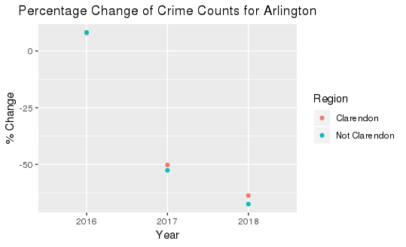
Initial EDA
Notes:
Crime incidences disclosure “Arlington County Data API was used for this purpose, but it is not endorsed or certified by Arlington County.”
this scatterplot shows the percent change of alcohl-related crime incidents that occurred both within the Clarendon area as well as outside the Clarendon area
the goal was to make a visualization that crime incidents have gone down after the ARI program was implemented but as you can see it also has gone down outside the Clarendon area since ARI

Slide 112

Proposed Methods: Difference-in-Difference [DID]
DIFFERENCE-IN-DIFFERENCE (DID) is used to estimate the policy effect by comparing the changes in outcomes over time between a population that is enrolled in a program (the treatment group) and a population that is not (the control group).
Source: Columbia University Mailman School of Public Health
Notes:
Bayoán

Slide 113


Proposed Methods: Hotspot Analysis and GWR
Source: ESRI Documentation
“A shaded area (C), such as one used in a choropleth map, also suggests equivalent risks of crime throughout the area with a dramatic reduction in risk at the border. It suggests that police activity throughout the area is appropriate” (Eck et al. 2005).
Notes:
Bayoán
Our proposed methods are those frequently found in the literature. For example, hotspot and geographic weighted regression analysis are techniques often used in the field for exploiting the spatial and temporal variation. These methods can identify trends and correlations (e.g., the effect of the program in the alcohol-related crimes incidence).

Slide 114
Strategy Going Forward
Compare Clarendon incident data before and after the Arlington Restaurant Initiative accounting for maturation effects (hotspot analysis)
Perform EDA to learn patterns in the data (social nightlife, special events, inclement weather)
Estimate impact of the program on alcohol-related crimes
Analyze the second-degree economic and social effects
Build dashboard for visualizing the data and analysis
Notes:
Bayoán
Crime incidents disclosure “Arlington County Data API was used for this purpose, but it is not endorsed or certified by Arlington County.”

Slide 115
Classifying Families and Households for VA Government
Stakeholders using Existing Administrative Records
PI: Brian Goode, Aaron Schroeder
Team: Megan Grondine, Daniel Liden, Alexa Nosal
Sponsor: Jeff Price VDSS

Slide 116
Outline
Project Overview
Project Status
Data Discovery
Data Exploration
Next Steps
116

Slide 117

Virginia Department of Social Services
“VDSS is one of the largest Commonwealth agencies, partnering with 120 local departments of social services, along with faith-based and non-profit organizations, to promote the well-being of children and families statewide.”
Services include:
Foster Care and Adoption
Child Care
Child Protective Services
Temporary Assistance for Needy Families
Many others

Slide 118
Project Status
Here’s where we are:
Identified stakeholders
Stakeholders have different needs for defining “family” and “nonfamily”
Researched background of VDSS system
Explored data dictionaries of OASIS, VaCMS, and NIS
Where we expect to be in 5 weeks:
Proof of concept using VDSS and publically available data
Depending on administrative hurdles
Notes:
This table gives investigator the ability to write a query, depending on their own definition of family.

Slide 119
Project Overview
Project Goal:
Determine the fitness of selected VDSS administrative data record systems for accurately deriving household and family classifications.
Develop a classification scheme for multiple family relationships
Sponsor Question:
“How many distinct individuals and families did we serve today?”
Jeff Price, VDSS Research and Planning
Sponsor Request:
Develop table containing network of relationships
Notes:
-largely reporting focused

Slide 120
Data Discovery: A Glance at Stakeholders
Child Protective Services
Childcare Subsidy
Child Support Enforcement
Foster Care
Medicaid
SNAP
TANF
Almost every stakeholder defines “family” and “household” differently.
Notes:
For every stakeholder, we researched and recorded their:
Family Definition
Other Relevant Household Definitions
Relevant Household or Family Unit
Policy Relevance
VA-specific case studies
In our example, we will talk discuss Childcare Subsidy and TANF. The Childcare Subsidy program permits eligible families to

Slide 121
The Problem
Childcare Subsidy
“Any individual(s), adult(s), and/or children related by blood, marriage, adoption or expression of kinship who function as a family unit.”
TANF
No definition of “family.” However, "assistance unit" means "those persons who must participate together as a family unit." (VA Admin code)
“Family cap” provision:
Allows child to receive benefits from nonfamily caretakers
TANF recipients also able to receive Childcare Subsidy benefits
Notes:
Family Cap Provision: a child can move in with relatives or unrelated caretakers and receive TANF benefits even if those benefits are unavailable in the birth parents' household.

Slide 122
Data Exploration: Data Dictionaries
NIS (National Incidence Study of Child Abuse and Neglect)
Identified ~50 relationship variables
OASIS (Online Automated Services Information System)
Identified 30+ tables and selected relevant variables
Familial/relationship/household indicators
VaCMS (Virginia Case Management System)
Identified 15 tables and selected relevant variables
Familial/relationship/household indicators
Notes:
NIS is from NDACAN (National Data Archive on Child Abuse and Neglect) dataset
data consists of broad-level studies on child-mistreatment incidences
includes demographic characteristics of both maltreated children and their families
OASIS: Child Welfare Information System in Virginia. Law requires every child in foster care to be tracked so that VDSS can monitor service delivery and planning for achieving permanency.
VaCMS: was designed to address the increased demand for eligibility determination, primarily as a result of health care reform. VaCMS filters data for SNAP, TANF, and Medicaid.

Slide 123


Data Exploration: Data Dictionaries
Relationships
Primary Caregiver
Biological Parent
Foster Parent
Adoptive Parent
Grandparent
Sibling
Friend
...
Notes:
OASIS: Child Welfare Information System in Virginia. Law requires every child in foster care to be tracked so that VDSS can monitor service delivery and planning for achieving permanency.
VaCMS: was designed to address the increased demand for eligibility determination, primarily as a result of health care reform. VaCMS filters data for SNAP, TANF, and Medicaid.
Public Data:
NIS (National Incidence Study of Child Abuse and Neglect)
Identified numerous columns of relationship information similar to that contained in the OASIS and VACMS databases
data consists of broad-level studies on child-mistreatment incidences
includes demographic characteristics of both maltreated children and their families

Slide 124
Next Steps
Weeks 6-10
July 11 - July 26
Proof of concept using NIS data
Create table of relationships
Incorporate VDSS data permitting
July 27-August 2
4. Finalize analysis
5. Make poster
August 2-August 9
6. Make final adjustments to data table
7. Present

Slide 125
Questions

Slide 127
UMFS: Increasing Retention and Decreasing Disruptions in Special-Needs Foster Care
SDAL Team: Daniel Liden & Armi Mosavian
SDAL Leads: Brian Goode & Josh Goldstein
Sponsor: United Methodist Foster Services (UMFS) - Richmond Division

Slide 128
UMFS
“UMFS is a nonprofit agency that provides a comprehensive array of programs to meet the needs of high-risk children and parents to enable them to overcome challenging circumstances and succeed.”
Focus on treatment foster care: providing a safe and structured home environment for foster children with special medical, emotional, social, and behavioral needs.
Provide training and ongoing support for foster parents providing treatment foster care to adolescents and teens throughout Virginia.
Notes:
motivate retention, recruitment is costly (so focus resources on retention)
experienced foster parents have been proven to be more successful (can also help with new foster parents + retaining them)

Slide 129
Project Overview
UMFS Goal is to map foster parent characteristics to core values to improve their understanding of recruitment to reduce the number of disruptions
To begin, we take a two-pronged approach:
understand retention and characteristics of current foster parents working with UMFS in comparison to all foster parents in RIC area.
conduct literature review to understand retention and recruitment with respect to reducing disruptions
Notes:
motivate retention, recruitment is costly (so focus resources on retention)
experienced foster parents have been proven to be more successful (can also help with new foster parents + retaining them)

Slide 130
Literature Review & Summary (1)
Previous Literature has suggested the following:
Characteristics of successful Foster Parents:
3 Topics: Personal, Motivations, and Environmental and Familial Factors
Strong support systems and good/clear communication with agency and agent have been reported as important factors
“Too Much Love” - Grief and Attachment
Better and more in depth training

Slide 131
Literature Review & Summary (2)
Willingness to Foster Special Needs:
Depends on the type of special needs
Parents are more likely to foster younger kids than teens (this aligned with UMFS findings, want to see how to change this)
Much work has been conducted by Dr. John Orme on this topic, and we plan to have a conversation with him in the coming weeks.

Slide 132
Data Sources
Current
UMFS Foster Family Data
169 rows of parent-level demographic data from Richmond, VA UMFS office
UMFS SalesForce Summary Data
Adoption and Foster Care Analysis and Reporting System (AFCARS) dataset, 2010-2016
4391 rows of child-level data from Richmond, VA.
Forthcoming
UMFS Home Studies

Slide 133


Foster Parent Date of Birth: RIC and UMFS

Slide 134



Slide 135
Next Steps
July 11 - July 26
Continue to explore AFCARS data and look into National Survey of Child and Adolescent Well-Being (NSCAW) data for anything that could relate to foster family retention.
Talk to Dr. Orme about his work on foster family retention and recruitment and special-needs fostering.
Derive specific recommendations about foster parent instruction and retention from the literature and data.
July 27 - August 2
Finalize analysis and prepare poster for symposium
August 2 - August 9
Prepare report for UMFS
Present results at symposium

Slide 136
Questions

Slide 137
Bibliography (1)
Brown, Jason D. “Foster Parents’ Perceptions of Factors Needed for Successful Foster Placements.” Journal of Child and Family Studies 17, no. 4 (August 1, 2008): 538–54. https://doi.org/10.1007/s10826-007-9172-z.
“Children and Youth with Disabilities in the Child Welfare System: An Overview - ProQuest.” Accessed June 5, 2018. https://search.proquest.com/openview/e4fff63ec4339ba06986a2514ebfdd6d/1?pq-origsite=gscholar&cbl=40853&casa_token=p0SqSSFAsD4AAAAA:Tx6JBtHhP4y68uG7OIa_TafJNJIrquM1A-QEiwfQSbtqac0B8MrBjljTYNEjpHJD_ialDZO8FA.
Crum, Wes. “Foster Parent Parenting Characteristics That Lead to Increased Placement Stability or Disruption.” Children and Youth Services Review 32, no. 2 (February 1, 2010): 185–90. https://doi.org/10.1016/j.childyouth.2009.08.022.
Department, Virginia, and Social Services. “Recruitment of Foster and Adoptive Families in Virginia: Market Segmentation Analyses,” n.d., 70.
Dodson, Diane. “Finding Families for Waiting Kids: The Challenge of Special Needs Adoption in the 90’s and Beyond,” n.d., 69.
Goemans, Anouk, Mitch van Geel, Merel van Beem, and Paul Vedder. “Developmental Outcomes of Foster Children: A Meta-Analytic Comparison With Children From the General Population and Children at Risk Who Remained at Home.” Child Maltreatment 21, no. 3 (August 2016): 198–217. https://doi.org/10.1177/1077559516657637.
Goemans, Anouk, Mitch van Geel, and Paul Vedder. “Over Three Decades of Longitudinal Research on the Development of Foster Children: A Meta-Analysis.” Child Abuse & Neglect 42 (April 1, 2015): 121–34. https://doi.org/10.1016/j.chiabu.2015.02.003.
Grimes-Vawters, Jennifer. “Identifying Future Effective Foster Parent Characteristics: Using the Casey Foster Family Assessment,” n.d., 107.
Lightfoot, Elizabeth. “Children and Youth with Disabilities in the Child Welfare System: An Overview.” Child Welfare 93, no. 2 (March 2014): 23–45.
Lightfoot, Elizabeth, Katharine Hill, and Traci LaLiberte. “Prevalence of Children with Disabilities in the Child Welfare System and out of Home Placement: An Examination of Administrative Records.” Children and Youth Services Review 33, no. 11 (November 1, 2011): 2069–75. https://doi.org/10.1016/j.childyouth.2011.02.019.

Slide 138
Bibliography (2)
Oosterman, Mirjam, Carlo Schuengel, N. Wim Slot, Ruud A.R. Bullens, and Theo A.H. Doreleijers. “Disruptions in Foster Care: A Review and Meta-Analysis.” Children and Youth Services Review 29, no. 1 (January 2007): 53–76. https://doi.org/10.1016/j.childyouth.2006.07.003.
Orme, John, Donna J. Cherry, and Mary Ellen Cox. “Measuring Willingness to Foster Children with Disabilities and Special Medical Conditions.” Social Work Research 37, no. 3 (September 1, 2013): 169–78. https://doi.org/10.1093/swr/svt013.
Orme, John G., and Donna J. Cherry. “The Vital Few Foster Parents: Replication and Extension.” Children and Youth Services Review 56 (September 1, 2015): 33–41. https://doi.org/10.1016/j.childyouth.2015.05.019.
Orme, John G., Donna J. Cherry, and Jason D. Brown. “Against All Odds: Vital Few Foster Families.” Children and Youth Services Review 79 (August 1, 2017): 584–93. https://doi.org/10.1016/j.childyouth.2017.07.019.
Orme, John G., Donna J. Cherry, and Taylor E. Krcek. “Who Is Willing to Foster Children With Disabilities?” Journal of Public Child Welfare 7, no. 5 (November 1, 2013): 566–85. https://doi.org/10.1080/15548732.2013.843494.
Pabustan-Claar, Jennifer. “Achieving Permanence in Foster Care for Young Children: A Comparison of Kinship and Non-Kinship Placements.” Journal of Ethnic And Cultural Diversity in Social Work 16, no. 1–2 (March 2007): 61–94. https://doi.org/10.1300/J051v16n01_03.
Randle, Melanie. “Through the Eyes of Ex-Foster Children: Placement Success and the Characteristics of Good Foster Carers.” Practice 25, no. 1 (2013): 3–19. https://doi.org/10.1080/09503153.2013.775236.
Semanchin Jones, Annette, and Susan Wells. “PATH/Wisconsin - Bremer Project: Preventing Placement Disruptions in Foster Care.” Literature Review. University of Minnesota School of Social Work, January 15, 2008. http://www.cehd.umn.edu/SSW/g-s/media/Final_report.pdf.
“Youth with Disabilities in the Foster Care System: Barriers to Success and Proposed Policy Solutions.” National Council on Disability, February 26, 2008. http://www.aypf.org/wp-content/uploads/2014/06/ncd96_FosterYouth_w_cover.pdf.

